Slide 1


Unit – 3 Relation
BTech & BSc (H)-CS $→$ 3rd Semester
Discrete Mathematics (2301HS301)
Prof. Vasudev Barjadiya
Department of Humanities & Science
vasudev.barjadiya@darshan.ac.in
901 64 27 400

Slide 2

Topics of Unit 3
Properties of Relation in a Set
Matrix and Graph Representation of a Relation
Partition and Covering of a Set
Equivalence Relation
Partially Ordered Relation
Cover and Hasse Diagram
Chains and Anti Chains
Totally Ordered Set
Least and Greatest Members, Minimal and Maximal Elements, and
Least Upper Bound and Greatest Lower Bound.
Looping

Slide 3

Looping
Outline of Unit 3
Properties of Relation in a Set
Reflexive Relation
Irreflexive Relation
Symmetric Relation
Asymmetric Relation
Anti-symmetric Relation
Transitive Relation
Matrix and Graph Representation of a Relation
Partition and Covering of a Set
Equivalence Relation
Equivalence class
Partially Ordered Relation

Slide 4

Looping
Outline of Unit 3
Hasse Diagram
Cover
Totally Ordered Set
Chains and Anti Chains
Least and Greatest Members, Minimal and Maximal Elements, and
Least Upper Bound and Greatest Lower Bound.

Slide 5
Prerequisite

Slide 6
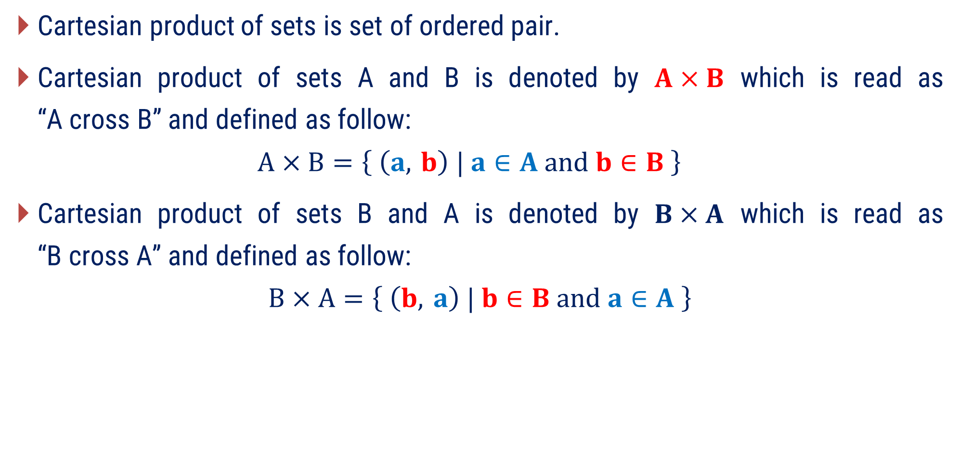
Cartesian Product of Sets
Cartesian product of sets is set of ordered pair.
Cartesian product of sets A and B is denoted by $A×B$ which is read as “A cross B” and defined as follow:
$$A×B=\left\{ \left(a, b\right) | a∈A and b∈B \right\}$$
Cartesian product of sets B and A is denoted by $B×A$ which is read as “B cross A” and defined as follow:
$$B×A=\left\{ \left(b, a\right) | b∈B and a∈A \right\}$$

Slide 7
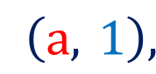


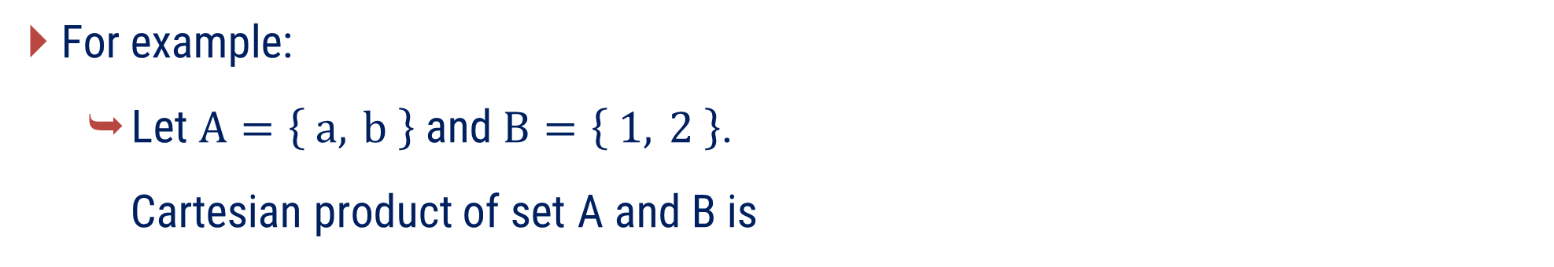
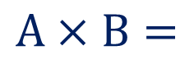


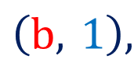
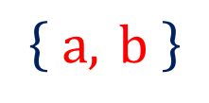
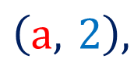
Cartesian Product of Sets
For example:
Let $A=\left\{ a, b \right\}$ and $B=\left\{ 1, 2 \right\}$.
Cartesian product of set A and B is
$$A×B=$$
$$\left\{ a, b \right\}$$
$$×\left\{ 1, 2 \right\}$$
$$A×B=$$
$$\left(a, 1\right),$$
$$\left(a, 2\right),$$
$$\left(b, 1\right),$$
$$\left(b, 2\right)$$

Slide 8
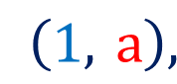

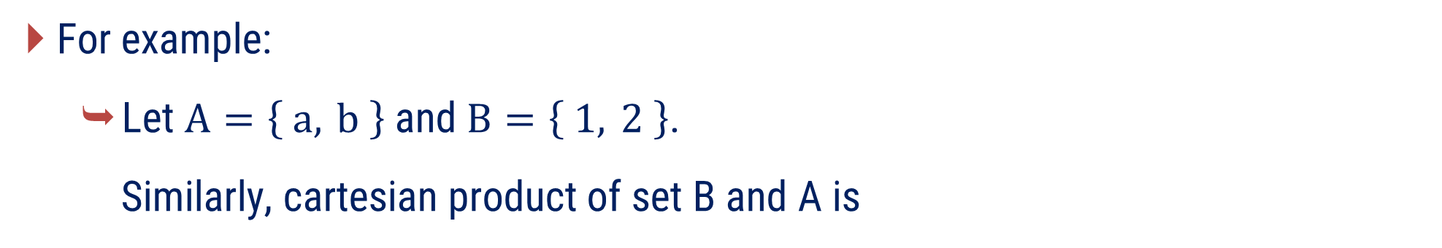



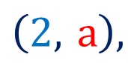

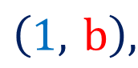
Cartesian Product of Sets
For example:
Let $A=\left\{ a, b \right\}$ and $B=\left\{ 1, 2 \right\}$.
Similarly, cartesian product of set B and A is
$$B×A=$$
$$\left\{ 1, 2 \right\}$$
$$×\left\{ a, b \right\}$$
$$B×A=$$
$$\left(1, a\right),$$
$$\left(1, b\right),$$
$$\left(2, a\right),$$
$$\left(2, b\right)$$

Slide 9
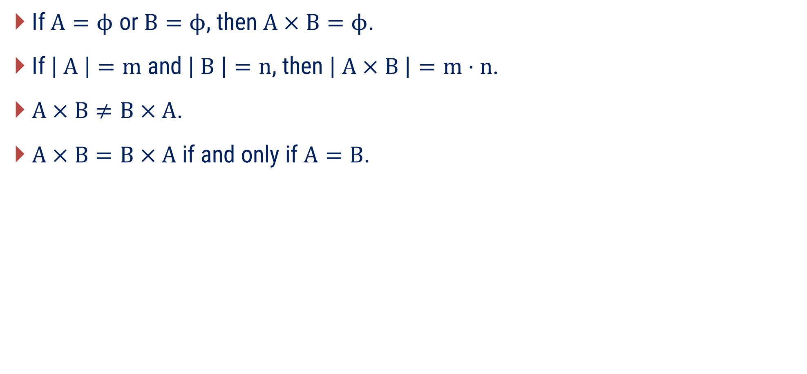
Properties of Cartesian Product
If $A=ϕ$ or $B=ϕ$, then $A×B=ϕ$.
If $\left| A \right|=m$ and $\left| B \right|=n$, then $\left| A×B \right|=m⋅n$.
$A×B≠B×A$.
$A×B=B×A$ if and only if $A=B$.

Slide 10
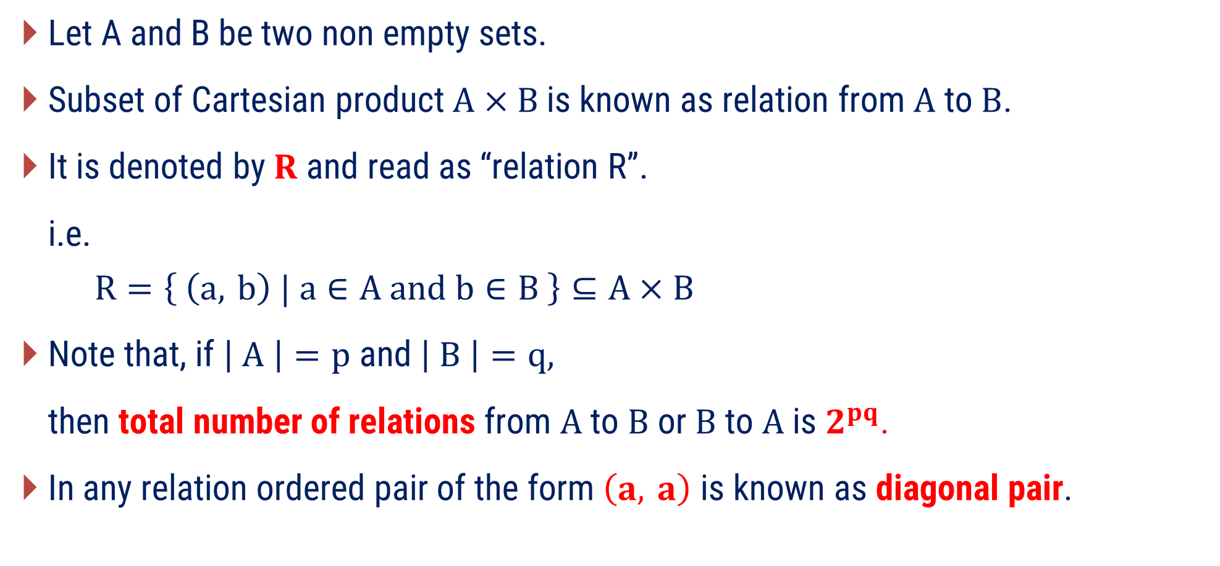
Relation or Binary Relation
Let A and B be two non empty sets.
Subset of Cartesian product $A×B$is known as relation from $A$ to $B$.
It is denoted by $R$ and read as “relation R”.
i.e.
$$R=\left\{ \left(a, b\right) | a∈A and b∈B \right\}⊆A×B$$
Note that, if $\left| A \right|=p$ and $\left| B \right|=q,$
then total number of relations from $A$ to $B$ or $B$ to $A$ is $2^{pq}$.
In any relation ordered pair of the form $\left(a, a\right)$ is known as diagonal pair.

Slide 11

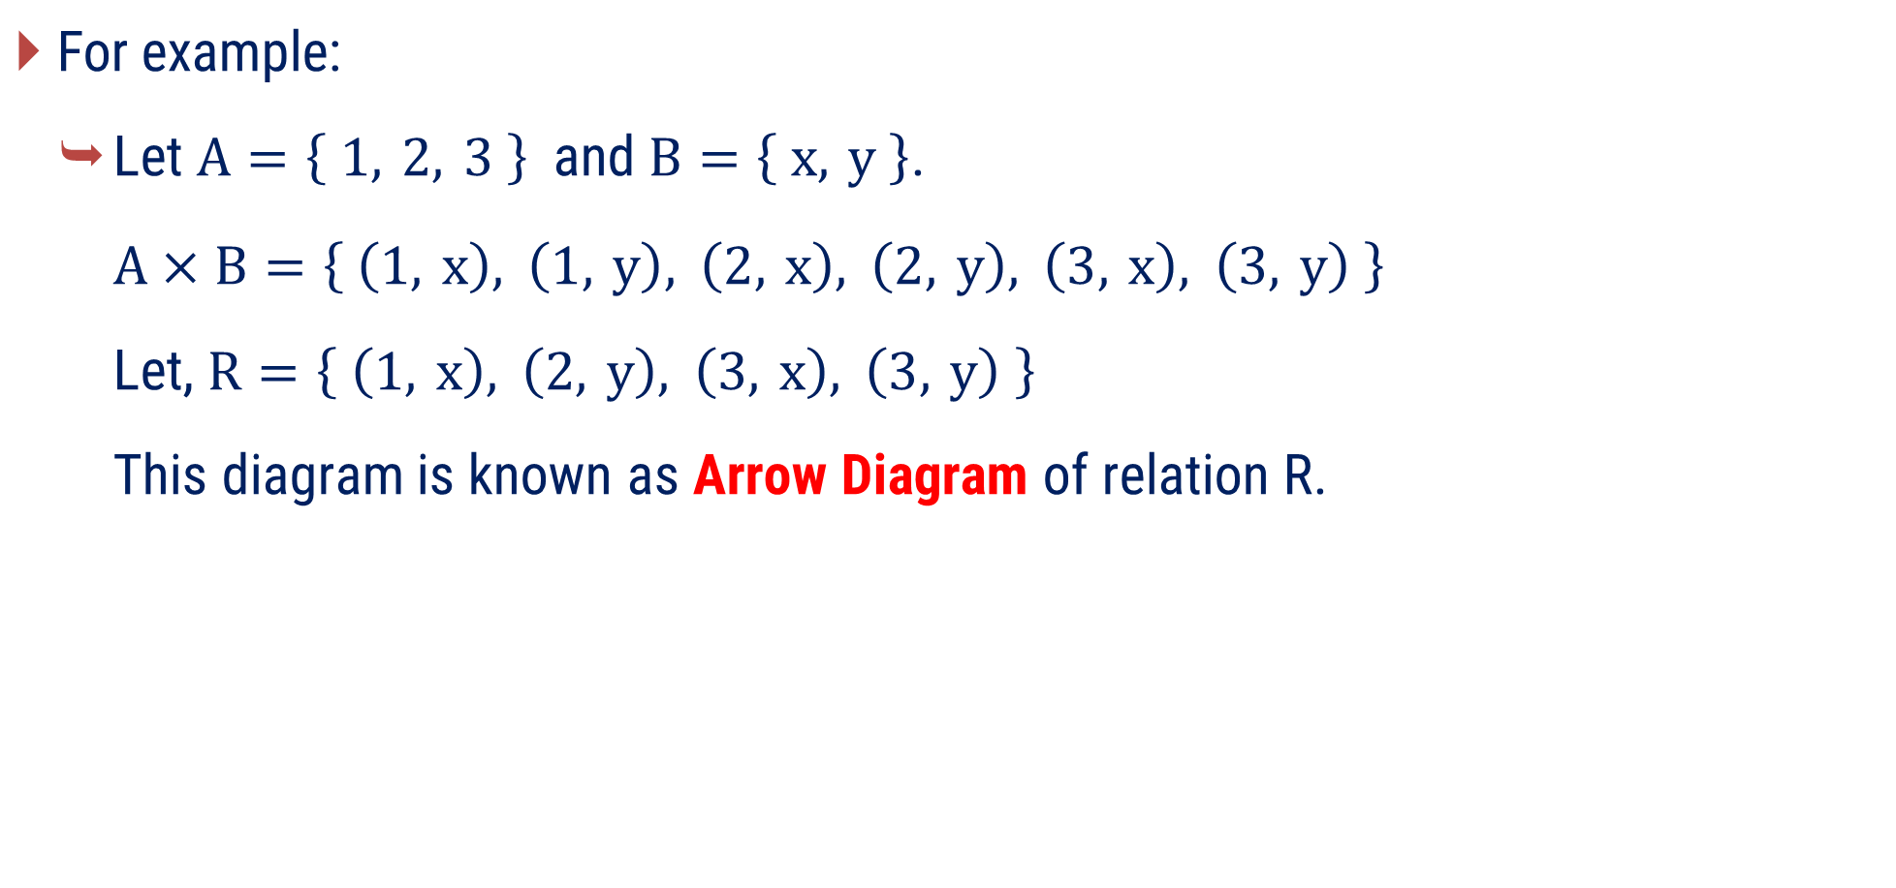

Relation or Binary Relation
A
B
$\text{For} \text{example}\text{:}$
Let $A=\left\{ 1, 2, 3 \right\}$ and $B=\left\{ x, y \right\}$.
$A×B=\left\{ \left(1, x\right), \left(1, y\right), \left(2, x\right), \left(2, y\right), \left(3, x\right), \left(3, y\right) \right\}$.
Let, $R=\left\{ \left(1, x\right), \left(2, y\right), \left(3, x\right), \left(3, y\right) \right\}$
This diagram is known as Arrow Diagram of relation R.
1
2
3
x
y
A
B
1
2
3
x
y
$$R$$
$$R$$

Slide 12
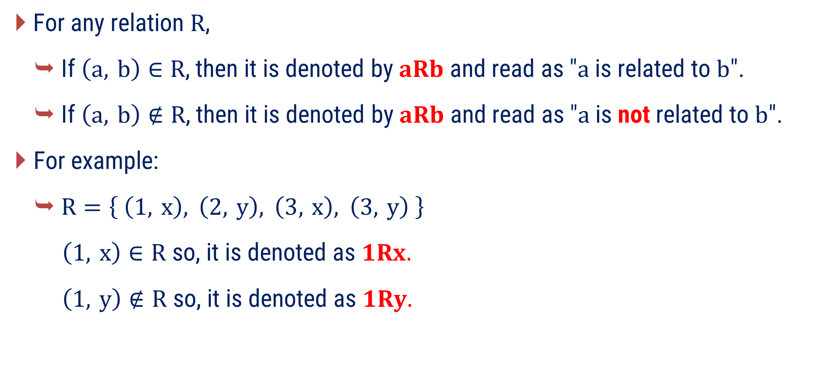
Relation or Binary Relation
For any relation $R$,
If $\left(a, b\right)∈R$, then it is denoted by $aRb$ and read as "$a$ is related to $b$".
If $\left(a, b\right)∉R$, then it is denoted by $aRb$ and read as "$a$ is not related to $b$".
For example:
$R=\left\{ \left(1, x\right), \left(2, y\right), \left(3, x\right), \left(3, y\right) \right\}$
$\left(1, x\right)∈R$ so, it is denoted as $1Rx.$
$\left(1, y\right)∉R$ so, it is denoted as $1Ry.$

Slide 13
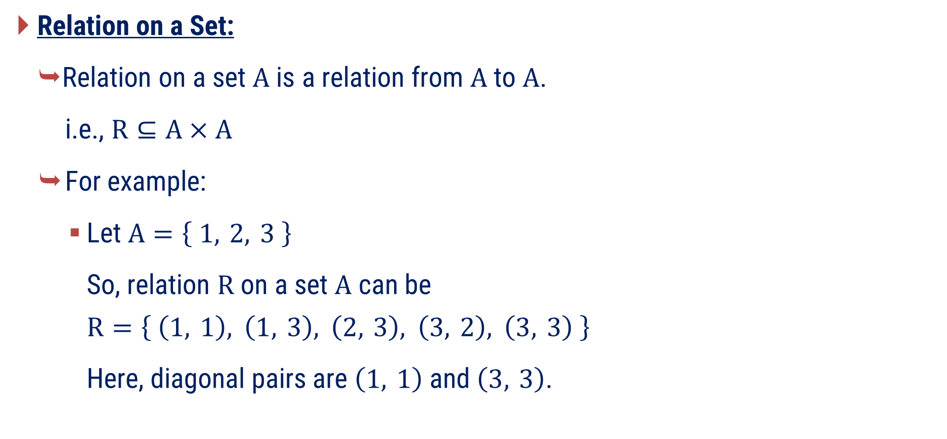
Relation or Binary Relation
Relation on a Set:
Relation on a set $A$ is a relation from $A$ to $A$.
i.e., $R⊆A×A$
For example:
Let $A=\left\{ 1, 2, 3 \right\}$
So, relation $R$ on a set $A$ can be
$$R=\left\{ \left(1, 1\right), \left(1, 3\right), \left(2, 3\right), \left(3, 2\right), \left(3, 3\right) \right\}$$
Here, diagonal pairs are $\left(1, 1\right)$ and $\left(3, 3\right)$.

Slide 14
Method 1
Properties of Relation

Slide 15
Properties of Relation
There are several properties that are used to classify relations on a set.
Reflexive Relation
Irreflexive Relation
Symmetric Relation
Asymmetric Relation
Anti-symmetric Relation
Transitive Relation

Slide 16

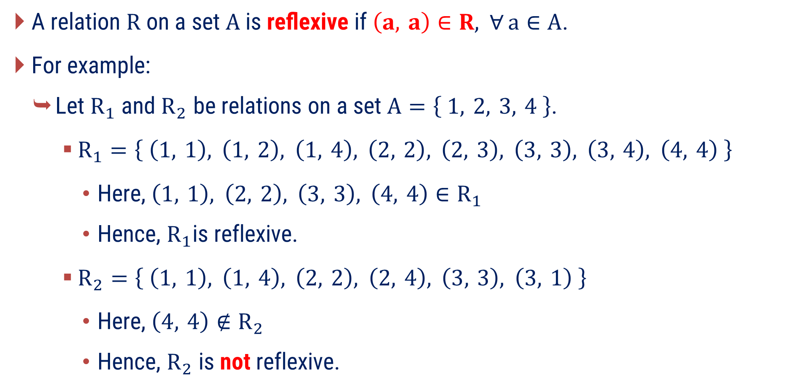
Reflexive Relation
A relation $R$ on a set $A$ is reﬂexive if $\left(a, a\right)∈R, ∀ a∈A$.
For example:
Let $R_{1}$ and $R_{2}$ be relations on a set $A=\left\{ 1, 2, 3, 4 \right\}$.
$R_{1}=\left\{ \left(1, 1\right), \left(1, 2\right), \left(1, 4\right), \left(2, 2\right), \left(2, 3\right), \left(3, 3\right), \left(3, 4\right), \left(4, 4\right) \right\}$
Here, $\left(1, 1\right), \left(2, 2\right), \left(3, 3\right), \left(4, 4\right)∈R_{1}$
Hence, $R_{1}$is reflexive.
$R_{2}=\left\{ \left(1, 1\right), \left(1, 4\right), \left(2, 2\right), \left(2, 4\right), \left(3, 3\right), \left(3, 1\right) \right\}$
Here, $\left(4, 4\right)∉R_{2}$
Hence, $R_{2}$ is not reflexive.
“$∀$” means “for every”

Slide 17
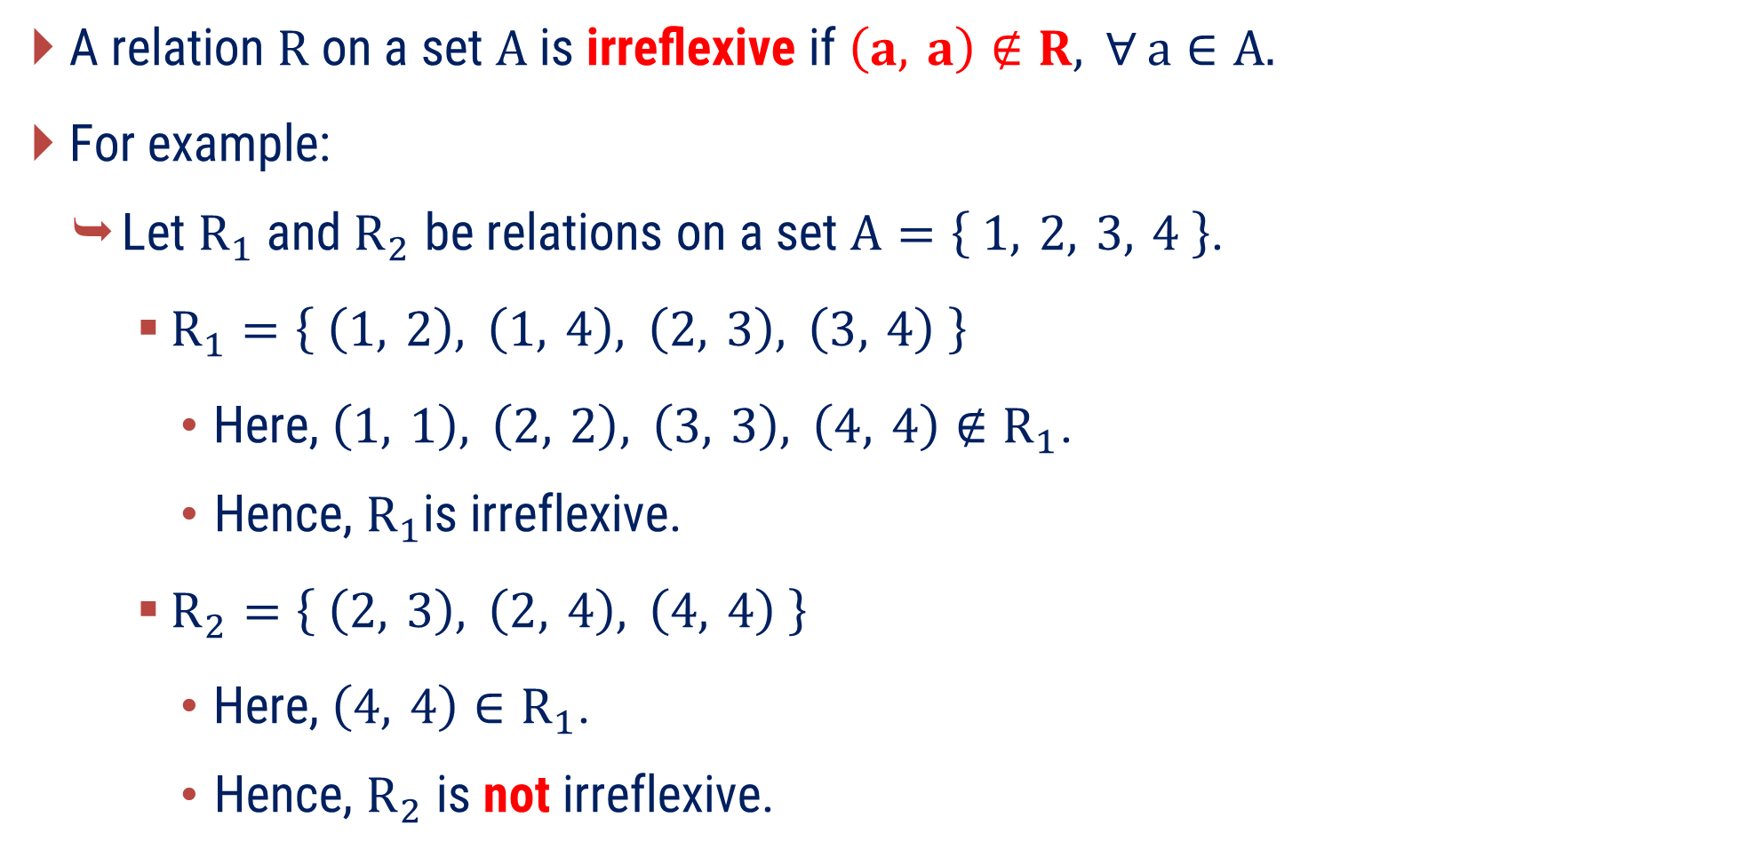
Irreflexive Relation
A relation $R$ on a set $A$ is irreﬂexive if $\left(a, a\right)∉R, ∀ a∈A.$
For example:
Let $R_{1}$ and $R_{2}$ be relations on a set $A=\left\{ 1, 2, 3, 4 \right\}$.
$R_{1}=\left\{ \left(1, 2\right), \left(1, 4\right), \left(2, 3\right), \left(3, 4\right) \right\}$
Here, $\left(1, 1\right), \left(2, 2\right), \left(3, 3\right), \left(4, 4\right)∉R_{1}\text{.}$
Hence, $R_{1}$is irreflexive.
$R_{2}=\left\{ \left(2, 3\right), \left(2, 4\right), \left(4, 4\right) \right\}$
Here, $\left(4, 4\right)∈R_{1}\text{.}$
Hence, $R_{2}$ is not irreflexive.

Slide 18
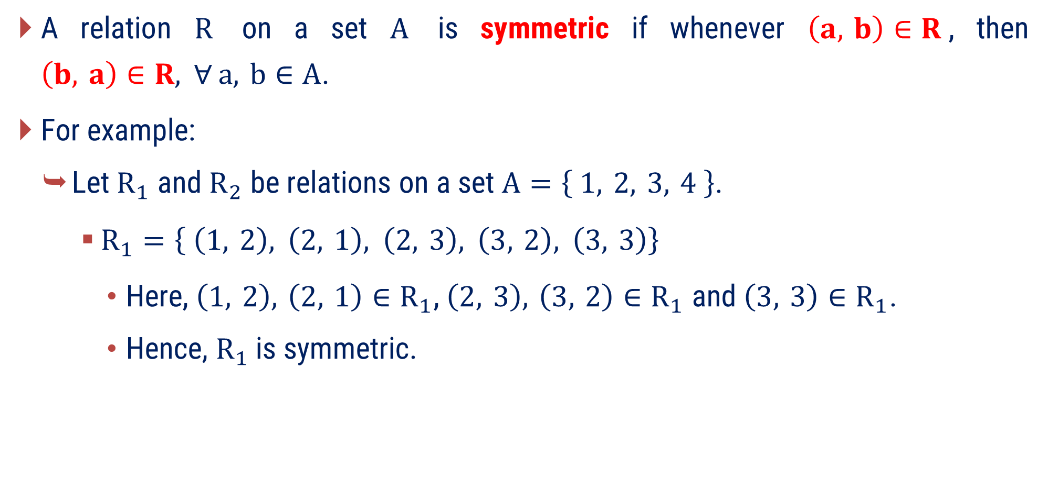
Symmetric Relation
A relation $R$ on a set $A$ is symmetric if whenever $\left(a, b\right)∈R$, then $\left(b, a\right)∈R, ∀ a, b∈A$.
For example:
Let $R_{1}$ and $R_{2}$ be relations on a set $A=\left\{ 1, 2, 3, 4 \right\}$.
$R_{1}=\left\{ \left(1, 2\right), \left(2, 1\right), \left(2, 3\right), \left(3, 2\right), \left(3, 3\right)\right\}$
Here, $\left(1, 2\right), \left(2, 1\right)∈R_{1}\text{, }\left(2, 3\right), \left(3, 2\right)∈R_{1}$ and $\left(3, 3\right)∈R_{1}$.
Hence, $R_{1}$ is symmetric.

Slide 19
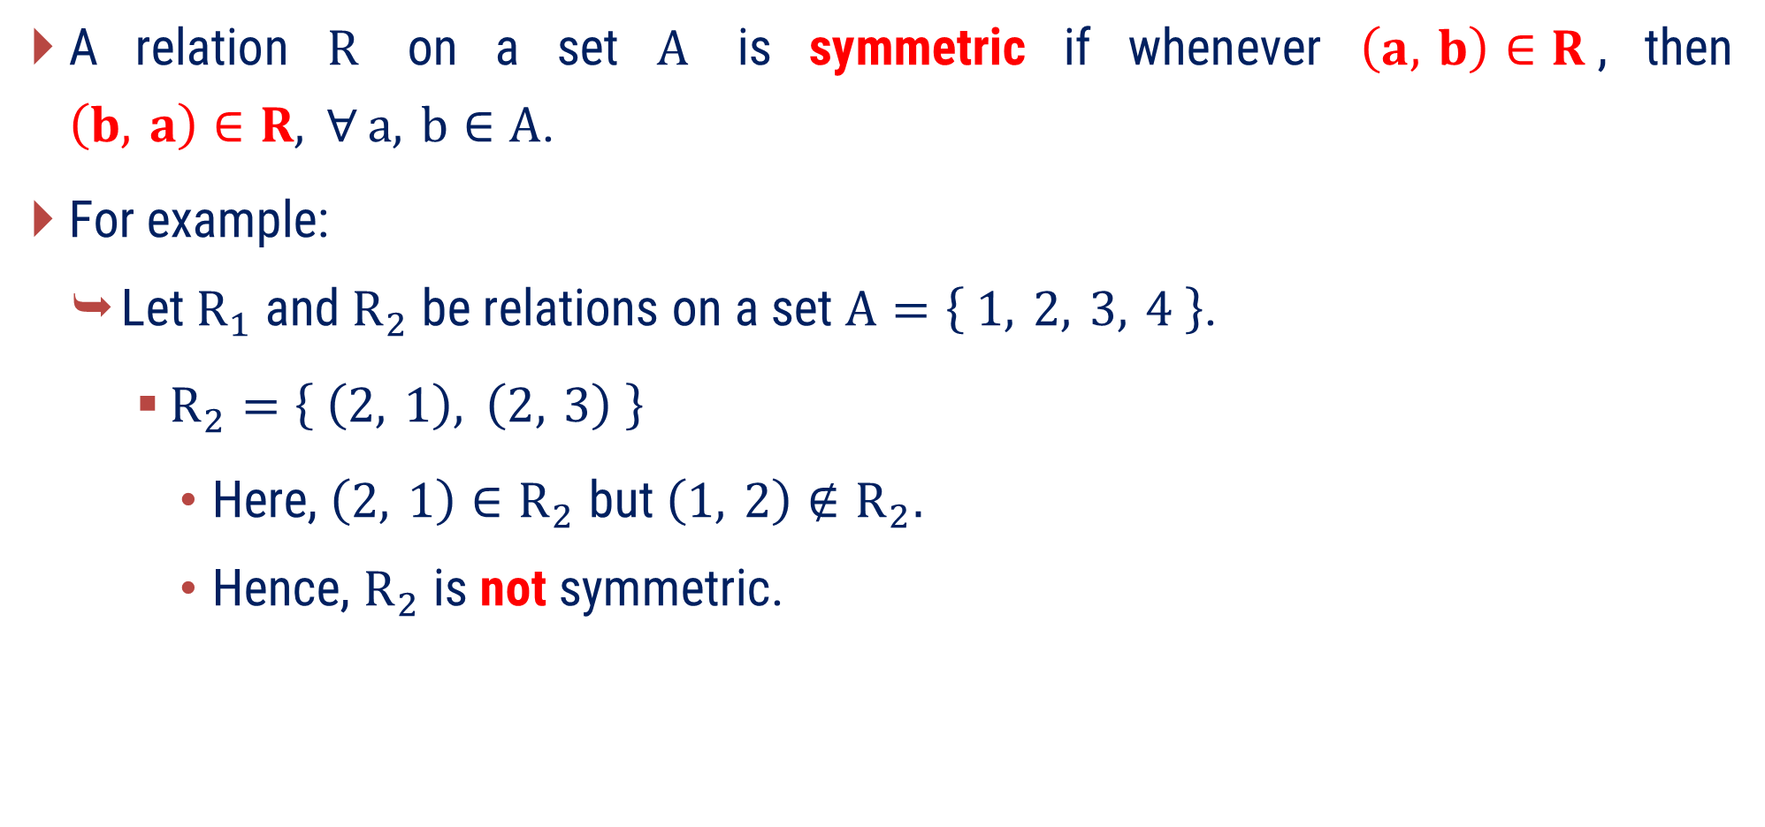
Symmetric Relation
A relation $R$ on a set $A$ is symmetric if whenever $\left(a, b\right)∈R$, then $\left(b, a\right)∈R, ∀ a, b∈A$.
For example:
Let $R_{1}$ and $R_{2}$ be relations on a set $A=\left\{ 1, 2, 3, 4 \right\}$.
$R_{2}=\left\{ \left(2, 1\right), \left(2, 3\right) \right\}$
Here, $\left(2, 1\right)∈R_{2}$ but $\left(1, 2\right)∉R_{2}.$
Hence, $R_{2}$ is not symmetric.

Slide 20
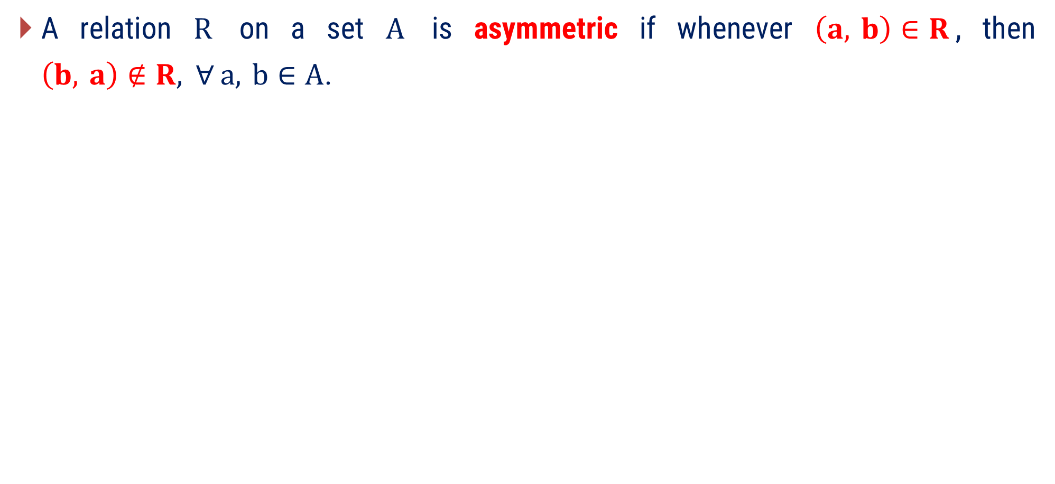
Asymmetric Relation
A relation $R$ on a set $A$ is asymmetric if whenever $\left(a, b\right)∈R$, then $\left(b, a\right)∉R, ∀ a, b∈A$.
Asymmetric relation does not contain diagonal pairs.

Slide 21
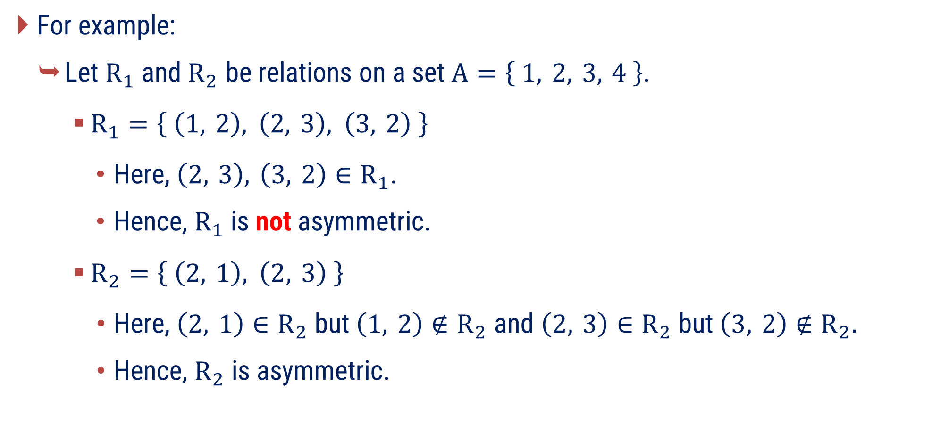
Asymmetric Relation
For example:
Let $R_{1}$ and $R_{2}$ be relations on a set $A=\left\{ 1, 2, 3, 4 \right\}$.
$R_{1}=\left\{ \left(1, 2\right), \left(2, 3\right), \left(3, 2\right) \right\}$
Here, $\left(2, 3\right), \left(3, 2\right)∈R_{1}$.
Hence, $R_{1}$ is not asymmetric.
$R_{2}=\left\{ \left(2, 1\right), \left(2, 3\right) \right\}$
Here, $\left(2, 1\right)∈R_{2}$ but $\left(1, 2\right)∉R_{2}$ and $\left(2, 3\right)∈R_{2}$ but $\left(3, 2\right)∉R_{2}.$
Hence, $R_{2}$ is asymmetric.

Slide 22
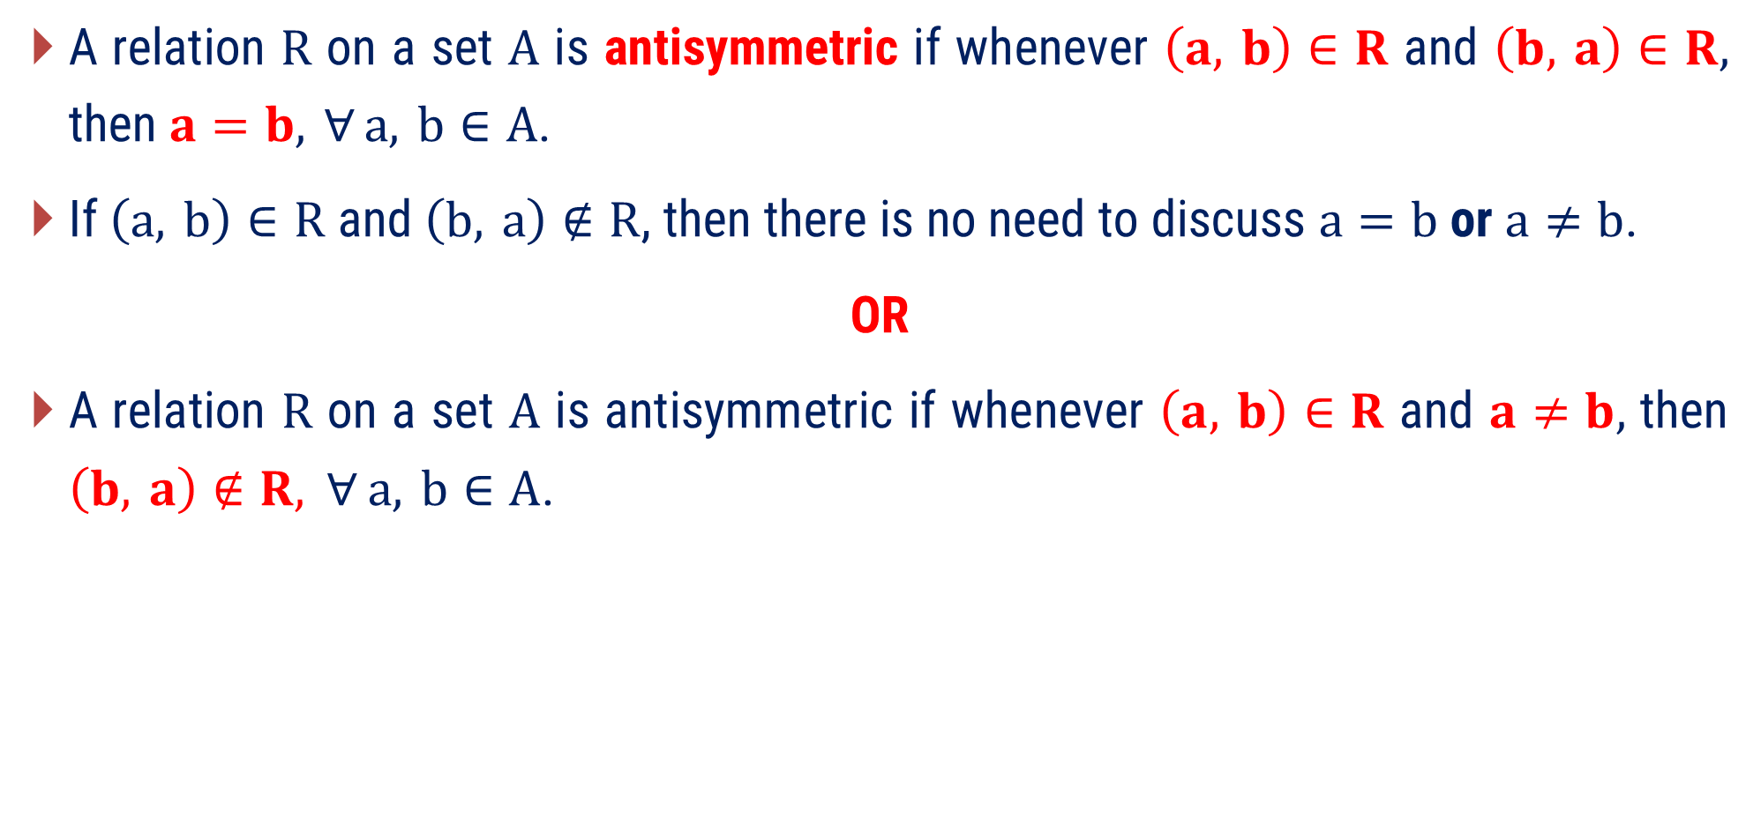
Antisymmetric Relation
A relation $R$ on a set $A$ is antisymmetric if whenever $\left(a, b\right)∈R$ and $\left(b, a\right)∈R,$ then $a=b, ∀ a, b∈A$.
If $\left(a, b\right)∈R$ and $\left(b, a\right)∉R$, then there is no need to discuss $a=b$ or $a≠b$.
OR
A relation $R$ on a set $A$ is antisymmetric if whenever $\left(a, b\right)∈R$ and $a≠b,$ then $\left(b, a\right)∉R, ∀ a, b∈A$.
Antisymmetric relation may contain diagonal pairs.

Slide 23
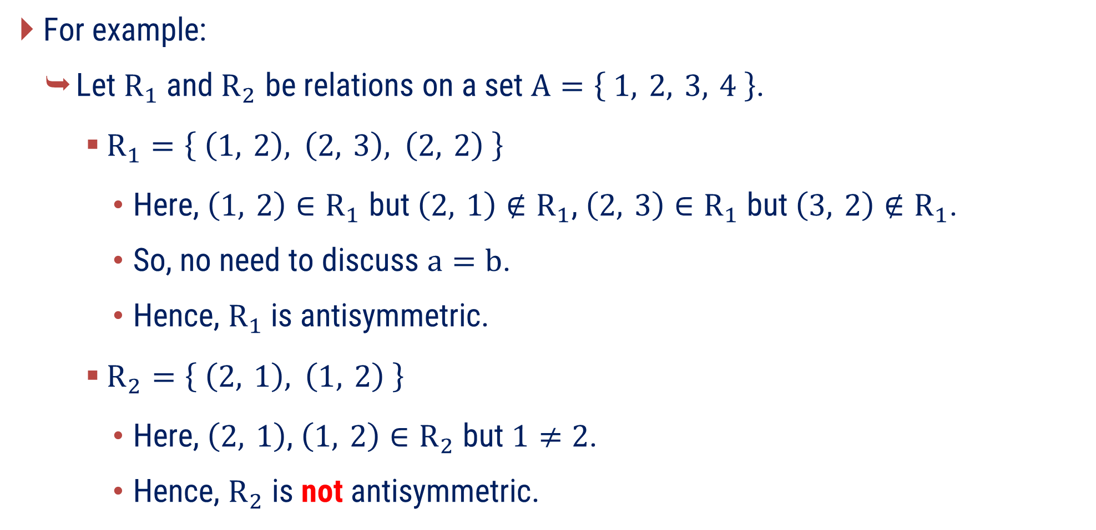
Antisymmetric Relation
For example:
Let $R_{1}$ and $R_{2}$ be relations on a set $A=\left\{ 1, 2, 3, 4 \right\}$.
$R_{1}=\left\{ \left(1, 2\right), \left(2, 3\right), \left(2, 2\right) \right\}$
Here, $\left(1, 2\right)∈R_{1}$ but $\left(2, 1\right)∉R_{1}\text{, }\left(2, 3\right)∈R_{1}$ but $\left(3, 2\right)∉R_{1}$.
So, no need to discuss $a=b$.
Hence, $R_{1}$ is antisymmetric.
$R_{2}=\left\{ \left(2, 1\right), \left(1, 2\right) \right\}$
Here, $\left(2, 1\right)$, $\left(1, 2\right)∈R_{2}$ but $1≠2$.
Hence, $R_{2}$ is not antisymmetric.

Slide 24
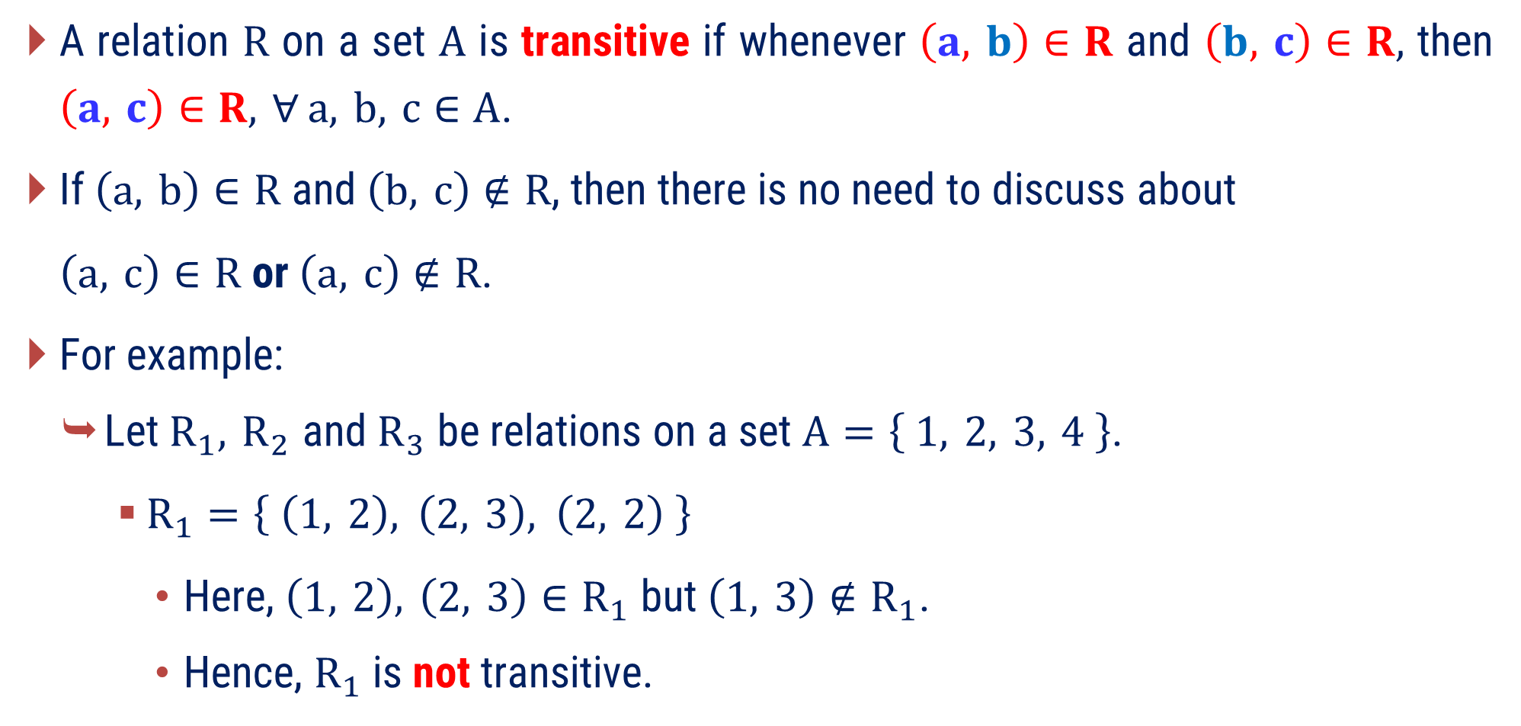
Transitive Relation
A relation $R$ on a set $A$ is transitive if whenever $\left(a, b\right)∈R$ and $\left(b, c\right)∈R,$ then $\left(a, c\right)∈R, ∀ a, b, c∈A$.
If $\left(a, b\right)∈R$ and $\left(b, c\right)∉R$, then there is no need to discuss about
$\left(a, c\right)∈R$ or $\left(a, c\right)∉R$.
For example:
Let $R_{1}, R_{2}$ and $R_{3}$ be relations on a set $A=\left\{ 1, 2, 3, 4 \right\}$.
$R_{1}=\left\{ \left(1, 2\right), \left(2, 3\right), \left(2, 2\right) \right\}$
Here, $\left(1, 2\right), \left(2, 3\right)∈R_{1}$ but $\left(1, 3\right)∉R_{1}$.
Hence, $R_{1}$ is not transitive.

Slide 25
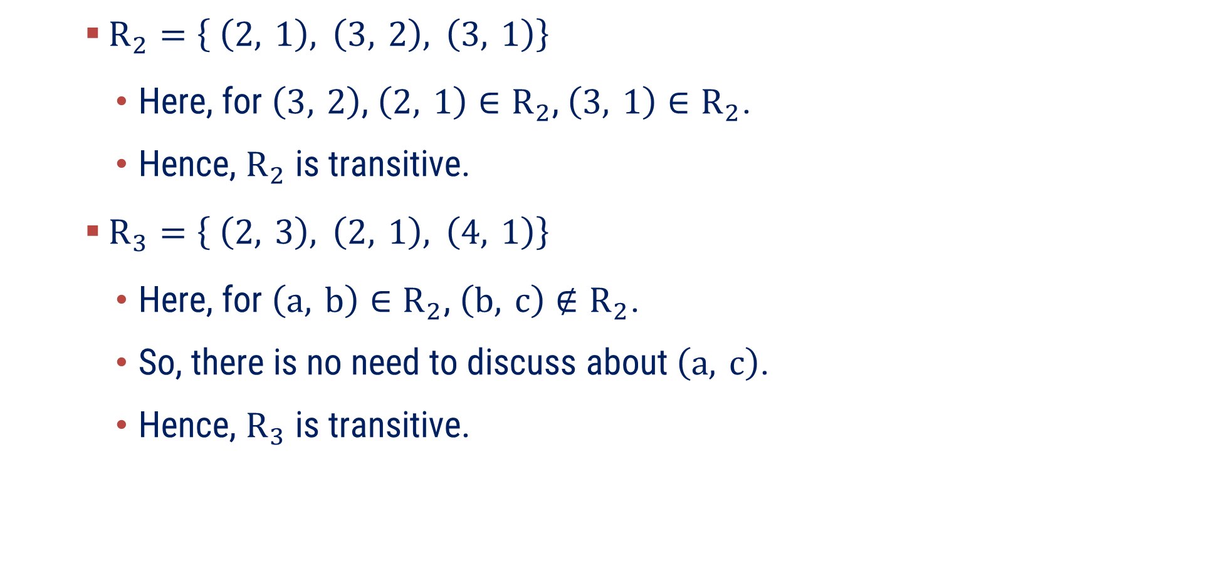
Transitive Relation
$R_{2}=\left\{ \left(2, 1\right), \left(3, 2\right), \left(3, 1\right)\right\}$
Here, for $\left(3, 2\right)$, $\left(2, 1\right)∈R_{2}$, $\left(3, 1\right)∈R_{2}$.
Hence, $R_{2}$ is transitive.
$R_{3}=\left\{ \left(2, 3\right), \left(2, 1\right), \left(4, 1\right)\right\}$
Here, for $\left(a, b\right)∈R_{2}$, $\left(b, c\right)∉R_{2}$.
So, there is no need to discuss about $\left(a, c\right)$.
Hence, $R_{3}$ is transitive.

Slide 26
Examples of Method 1
Properties of Relation

Slide 27
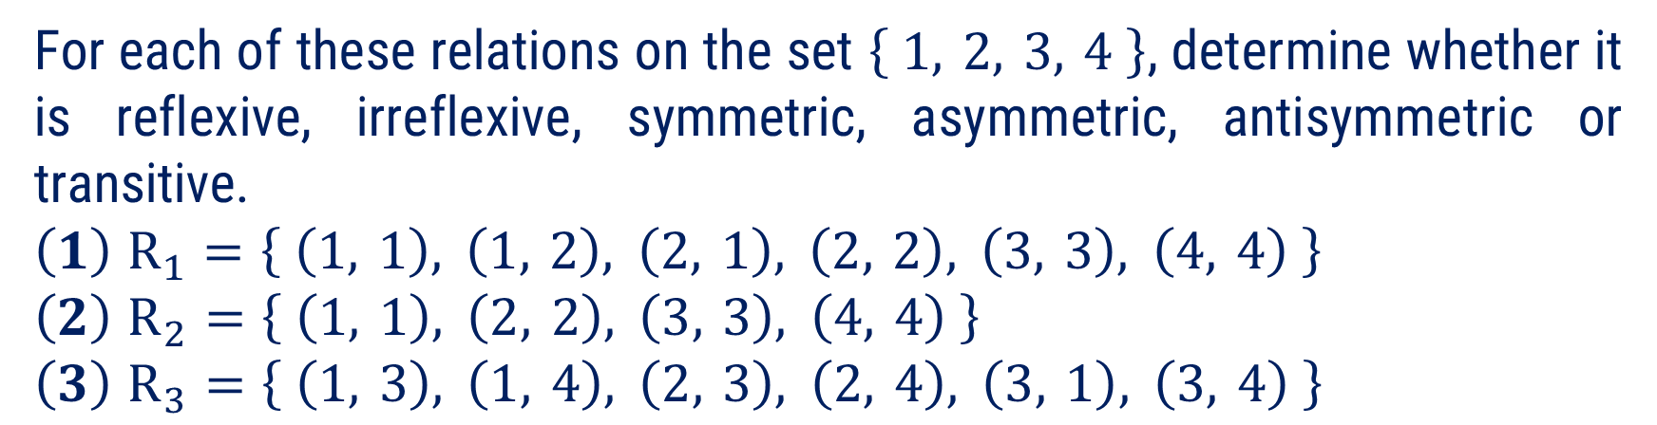


Method 1 ⇝ Example 1
Question:
For each of these relations on the set $\left\{ 1, 2, 3, 4 \right\}$, determine whether it is reflexive, irreflexive, symmetric, asymmetric, antisymmetric or transitive.
$$\left(1\right) R_{1}=\left\{ \left(1, 1\right), \left(1, 2\right), \left(2, 1\right), \left(2, 2\right), \left(3, 3\right), \left(4, 4\right) \right\}$$
$$\left(2\right) R_{2}=\left\{ \left(1, 1\right), \left(2, 2\right), \left(3, 3\right), \left(4, 4\right) \right\}$$
$$\left(3\right) R_{3}=\left\{ \left(1, 3\right), \left(1, 4\right), \left(2, 3\right), \left(2, 4\right), \left(3, 1\right), \left(3, 4\right) \right\}$$
Solution:
$$\left(1\right) R_{1}=\left\{ \left(1, 1\right), \left(1, 2\right), \left(2, 1\right), \left(2, 2\right), \left(3, 3\right), \left(4, 4\right) \right\}$$
Reflexive
Here,
$$\left(1, 1\right), \left(2, 2\right), \left(3, 3\right), \left(4, 4\right)∈R_{1}$$
So, $R_{1}$ is reflexive.
Irreflexive
Since, $R_{1}$ is reflexive, it is not irreflexive.

Slide 28

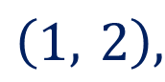
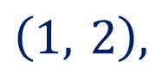



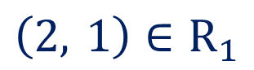

Method 1 ⇝ Example 1 (Continue)
$$\left(1\right) R_{1}=\left\{ \left(1, 1\right), \left(1, 2\right), \left(2, 1\right), \left(2, 2\right), \left(3, 3\right), \left(4, 4\right) \right\}$$
Symmetric
Here,
$$\left(1, 2\right),$$
$$\left(2, 1\right)∈R_{1}$$
So, $R_{1}$ is symmetric.
Asymmetric
Since, $R_{1}$ is symmetric, it is not asymmetric.
Antisymmetric
Here,
$$\left(1, 2\right),$$
$$\left(2, 1\right)∈R_{1}$$
but $1≠2$
So, $R_{1}$ is not antisymmetric.

Slide 29

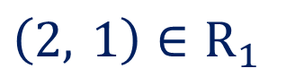
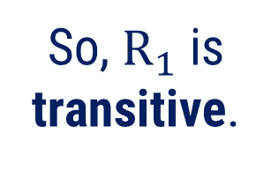

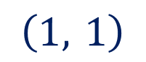

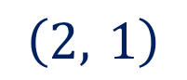

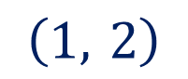
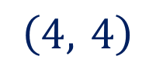


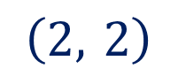
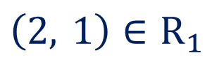


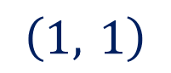


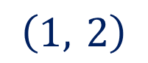
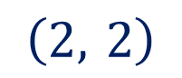
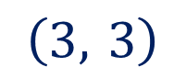

Method 1 ⇝ Example 1 (Continue)
$$\left(1\right) R_{1}=\left\{ \left(1, 1\right), \left(1, 2\right), \left(2, 1\right), \left(2, 2\right), \left(3, 3\right), \left(4, 4\right) \right\}$$
Transitive
$$(a, b)$$ | $$(b, c)$$ | $$(a, c)$$
$$\left(1, 1\right)$$
$$\left(1, 2\right)$$
$$\left(1, 2\right)∈R_{1}$$
So, $R_{1}$ is transitive.
$$\left(2, 1\right)$$
$$\left(1, 1\right)∈R_{1}$$
$$\left(1, 2\right)$$
$$\left(2, 2\right)$$
$$\left(1, 2\right)∈R_{1}$$
$$\left(1, 1\right)$$
$$\left(2, 1\right)∈R_{1}$$
$$\left(2, 1\right)$$
$$\left(1, 2\right)$$
$$\left(2, 2\right)∈R_{1}$$
$$\left(2, 2\right)$$
$$\left(2, 1\right)$$
$$\left(2, 1\right)∈R_{1}$$
$$\left(3, 3\right)$$
$$−$$
$$−$$
$$\left(4, 4\right)$$
$$−$$
$$−$$

Slide 30





Method 1 ⇝ Example 1 (Continue)
$$\left(2\right) R_{2}=\left\{ \left(1, 1\right), \left(2, 2\right), \left(3, 3\right), \left(4, 4\right) \right\}$$
Reflexive
Here,
$$\left(1, 1\right), \left(2, 2\right), \left(3, 3\right), \left(4, 4\right)∈R_{2}$$
So, $R_{2}$ is reflexive.
Irreflexive
Since, $R_{2}$ is reflexive, it is not irreflexive.
Symmetric
Here,
$$\left(1, 1\right), \left(2, 2\right), \left(3, 3\right), \left(4, 4\right)∈R_{2}$$
So, $R_{2}$ is symmetric.
Asymmetric
Since, $R_{2}$ is symmetric, it is not asymmetric.
Antisymmetric
$R_{2}$ is antisymmetric.
As all pairs are diagonal pairs.

Slide 31


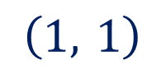

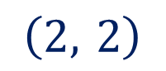

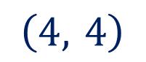

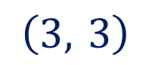

Method 1 ⇝ Example 1 (Continue)
$$\left(2\right) R_{2}=\left\{ \left(1, 1\right), \left(2, 2\right), \left(3, 3\right), \left(4, 4\right) \right\}$$
Transitive
$$(a, b)$$ | $$(b, c)$$ | $$(a, c)$$
$$\left(1, 1\right)$$
$$−$$
$$−$$
$$\left(2, 2\right)$$
$$−$$
$$−$$
$$\left(3, 3\right)$$
$$−$$
$$−$$
$$\left(4, 4\right)$$
$$−$$
$$−$$
So, $R_{2}$ is transitive.

Slide 32

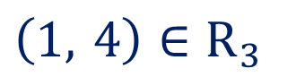



Method 1 ⇝ Example 1 (Continue)
$$\left(3\right) R_{3}=\left\{ \left(1, 3\right), \left(1, 4\right), \left(2, 3\right), \left(2, 4\right), \left(3, 1\right), \left(3, 4\right) \right\}$$
Reflexive
Here,
$$\left(1, 1\right), \left(2, 2\right), \left(3, 3\right), \left(4, 4\right)∉R_{3}$$
So, $R_{2}$ is not reflexive.
Irreflexive
Here,
$$\left(1, 1\right), \left(2, 2\right), \left(3, 3\right), \left(4, 4\right)∉R_{3}$$
So, $R_{2}$is irreflexive.
Symmetric
Here,
$$\left(1, 4\right)∈R_{3}$$
but $\left(4, 1\right)∉R_{3}$
$R_{2}$ is not symmetric.

Slide 33


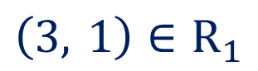
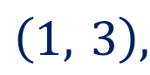
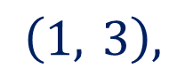


Method 1 ⇝ Example 1 (Continue)
$$\left(3\right) R_{3}=\left\{ \left(1, 3\right), \left(1, 4\right), \left(2, 3\right), \left(2, 4\right), \left(3, 1\right), \left(3, 4\right) \right\}$$
Asymmetric
Here,
$$\left(1, 3\right),$$
$$\left(3, 1\right)∈R_{3}$$
So, $R_{3}$ is not asymmetric.
Antisymmetric
Here,
$$\left(1, 3\right),$$
$$\left(3, 1\right)∈R_{1}$$
but $1≠3$
So, $R_{1}$ is not antisymmetric.

Slide 34




Method 1 ⇝ Example 1 (Continue)
$$\left(3\right) R_{3}=\left\{ \left(1, 3\right), \left(1, 4\right), \left(2, 3\right), \left(2, 4\right), \left(3, 1\right), \left(3, 4\right) \right\}$$
Transitive
$$(a, b)$$ | $$(b, c)$$ | $$(a, c)$$
$$\left(1, 3\right)$$
$$\left(3, 1\right)$$
$$\left(1, 1\right)∉R_{3}$$
So, $R_{3}$ is not transitive.

Slide 35













Method 1 ⇝ Example 2
Question:
Let$A=\left\{ 1, 2, 3, 4, 5, 6 \right\}$and define a relation $R$ on $A$ as $R=\left\{ \left(x, y\right) | y \text{is} \text{divisible} \text{by} x \right\}$.
Check whether $R$ is reflexive, symmetric or transitive.
Solution:
Reflexive
Symmetric
For all $x∈A$,
$x$ is divisible by $x$.
Here, $2$ is divisible by $1$.
$$⇒$$
$$\left(x, x\right)∈R$$
$$⇒$$
$$\left(1, 2\right)∈R$$
So, $R$ is reflexive.
But, $1$ is not divisible by $2$.
$$⇒$$
$$\left(2, 1\right)∉R$$
So, $R$ is not symmetric.

Slide 36






















Method 1 ⇝ Example 2 (Continue)
Transitive
Let $x, y, z∈A$
such that
$(x, y)∈R$ and $(y, z)∈R$.
$$⇒$$
$y$ is divisible by $x$
and
$z$is divisible by $y.$
$$⇒$$
$$y=bx$$
and
$$z=cy$$
for some $b, c∈ℤ^{+}$
$$⇒$$
$$z=$$
$$c\left( \right)$$
$$bx$$
$$⇒$$
$$z=$$
$$\left( \right)x$$
$$cb$$
$$⇒$$
$z$is divisible by $x.$
$$⇒$$
$$\left(x, z\right)∈R$$
So, $R$ is transitive.

Slide 37
Method 2
Matrix and Graph Representation of a Relation

Slide 38

Matrix Representation of a Relation
A relation between ﬁnite sets can be represented using a zero–one matrix.
Suppose that $R$ is a relation from $A=\left\{ a_{1}, a_{2}, …, a_{m} \right\}$ to $B=\left\{ b_{1}, b_{2}, …, b_{n} \right\}$.
The relation $R$ can be represented by the matrix $M_{R}={\left[ m_{ij} \right]}_{m×n}$, where
$$m_{ij}=\left\{ \begin{aligned}1, if \left(a_{i}, b_{j}\right)∈R, \\ \\ &0, if \left(a_{i}, b_{j}\right)∉R.\end{aligned}\right.$$
A matrix of relation $R$ on a set $A$ is always square matrix.

Slide 39














Matrix Representation of a Relation
For example:
Let $A=\left\{ 1, 2, 3 \right\}$, $B=\left\{ x, y \right\}$ and $R$ be the relation from $A$ defined as $R=\left\{ \left(1, x\right), \left(2, y\right), \left(3, x\right), \left(3, y\right) \right\}$.
$$x$$
$$y$$
$$1$$
$$1$$
$$0$$
$$M_{R}=$$
$$2$$
$$0$$
$$1$$
$$3$$
$$1$$
$$1$$

Slide 40





Graph (Digraph) Representation of a Relation
The relation $R$ on a set $A$ is represented by the directed graph that has the elements of $A$ as its vertices and the ordered pairs $\left(a, b\right)∈R$, as edges.
For example:
Let $A=\left\{ 1, 2, 3, 4 \right\}$ and $R$ be the relation on $A$ defined as
$$R=\left\{\begin{aligned} \\ \begin{aligned} \left(1, 3\right), \left(1, 4\right), \left(2, 1\right), \left(2, 2\right), \left(2, 3\right), \\ \begin{aligned} \\ \left(3, 1\right), \left(3, 3\right), \left(4, 1\right), \left(4, 3\right) \end{aligned}\end{aligned} \\ \end{aligned}\right\}$$
$$1$$
$$2$$
$$4$$
$$3$$

Slide 41
Examples of Method 2
Matrix and Graph Representation of a Relation

Slide 42




























Method 2 ⇝ Example 1
Question:
Represent given relation $R$ on $\left\{ 1, 2, 3, 4 \right\}$ with a matrix also draw a directed graph of it.
$$R=\left\{ \left(1, 1\right), \left(1, 2\right), \left(1, 3\right), \left(1, 4\right), \left(2, 4\right),\left(3, 1\right), \left(3, 2\right), \left(4, 2\right), \right.$$
$$\left. \left(4, 3\right), \left(4, 4\right) \right\}$$
Solution:
Matrix Representation of a Relation:
$$1$$
$$2$$
$$3$$
$$4$$
$$1$$
$$1$$
$$1$$
$$1$$
$$1$$
$$2$$
$$0$$
$$0$$
$$0$$
$$1$$
$$M_{R}=$$
$$3$$
$$1$$
$$1$$
$$0$$
$$0$$
$$4$$
$$0$$
$$1$$
$$1$$
$$1$$

Slide 43





Method 2 ⇝ Example 1 (Continue)
$$R=\left\{ \left(1, 1\right), \left(1, 2\right), \left(1, 3\right), \left(1, 4\right), \left(2, 4\right),\left(3, 1\right), \left(3, 2\right), \left(4, 2\right), \right.$$
$$\left. \left(4, 3\right), \left(4, 4\right) \right\}$$
Digraph of a Relation:
$$1$$
$$2$$
$$4$$
$$3$$

Slide 44
Method 3
Partition and Covering of a Set

Slide 45


Covering and Partition of a Set
Let $S$ be a nonempty finite set. Let $A_{1}, A_{2}, …, A_{k}$ be nonempty subsets of $S$.
If , then $\left\{ A_{1}, A_{2}, …, A_{k} \right\}$ is known as covering of a set $S.$
Furthermore, if $A_{i}∩A_{j}=φ, ∀ A_{i}≠A_{j}$, then $\left\{ A_{1}, A_{2}, …, A_{k} \right\}$ is known as partition of a set $S.$
The sets $A_{1}, A_{2}, …, A_{k}$ are known as block of partition.
$$\bigcup_{i=1}^{k}{A_{i}}=S$$
Note that, every partition is covering but covering may not be partition.

Slide 46

Covering and Partition of a Set
For example:
Let $B_{1}, B_{2}$ and $B_{3}$ be collections of subsets of $S=\left\{ 1, 2, …, 8, 9 \right\}$
$B_{1}=\left\{ \left\{ 1, 3, 5 \right\}, \left\{ 2, 6 \right\}, \left\{ 4, 8, 9 \right\} \right\}$
Here, $7$ does not belong to any of the subset.
Hence, $B_{1}$ is neither covering nor partition of $S$.
$B_{2}=\left\{ \left\{ 1, 3, 5 \right\}, \left\{ 2, 4, 6, 8 \right\}, \left\{ 5, 7, 9 \right\} \right\}$
Here, $\left\{ 1, 3, 5 \right\}∪\left\{ 2, 4, 6, 8 \right\}∪\left\{ 5, 7, 9 \right\}=S$ but
$$\left\{ 1, 3, 5 \right\}∩\left\{ 5, 7, 9 \right\}≠φ$$
Hence, $B_{2}$ is covering but not partition.

Slide 47

Covering and Partition of a Set
For example:
Let $B_{1}, B_{2}$ and $B_{3}$ be collections of subsets of $S=\left\{ 1, 2, …, 8, 9 \right\}$
$B_{3}=\left\{ \left\{ 1, 3, 5 \right\}, \left\{ 2, 4, 6, 8 \right\}, \left\{ 7, 9 \right\} \right\}$
Here, $\left\{ 1, 3, 5 \right\}∪\left\{ 2, 4, 6, 8 \right\}∪\left\{ 5, 7, 9 \right\}=S$ and
all subsets are mutually disjoint.
Hence, $B_{3}$ is partition of $S$.
Since, it is partition it is covering.
$\left\{ 1, 3, 5 \right\}, \left\{ 2, 4, 6, 8 \right\}$ and $\left\{ 7, 9 \right\}$ are blocks of partition.

Slide 48
Examples of Method 3
Partition and Covering of a Set

Slide 49





Method 3 ⇝ Example 1
Question:
Let $S=\left\{ a, b, c, d, e, f, g \right\}$ be a set and $A_{1}=\left\{ a, c, e \right\}, A_{2}=\left\{ b \right\},$ $A_{3}=\left\{ d, g \right\}, A_{4}=\left\{ d, f \right\}, A_{5}=\left\{ f \right\}$ be subsets of $S.$
Determine which of the collection is covering or partition:
$$P_{1}=\left\{ A_{1}, A_{2}, A_{3} \right\}, P_{2}=\left\{ A_{1}, A_{2}, A_{3}, A_{4}, A_{5} \right\}$$
$$P_{3}=\left\{ A_{1}, A_{2}, A_{3}, A_{5} \right\}$$
Solution:
$P_{1}=\left\{ A_{1}, A_{2}, A_{3} \right\}$
$$=\left\{ \left\{a, c, e\right\}, \left\{b\right\}, \left\{d, g\right\} \right\}$$
Here,
element $f$ does not belong to any of the subset.
So, $P_{1}$ is neither covering nor partition.

Slide 50







Method 3 ⇝ Example 1 (Continue)
$$P_{2}=\left\{ A_{1}, A_{2}, A_{3}, A_{4} \right\}$$
$$=\left\{ \left\{ a, c, e \right\}, \left\{ b \right\}, \left\{ d, g \right\}, \left\{ d, f \right\} \right\}$$
Here,
$$\left\{ a, c, e \right\}∪\left\{ b \right\}∪\left\{ d, g \right\}∪\left\{ d, f \right\}$$
$$=\left\{ a, b, c, d, e, f, g \right\}$$
$$=S$$
Here,
$$A_{3}∩A_{4}$$
$$=\left\{ d, g \right\}∩\left\{ d, f \right\}$$
$$=\left\{ d \right\}$$
$$≠φ$$
So, $P_{2}$ is covering but not partition.

Slide 51




Method 3 ⇝ Example 1 (Continue)
$$P_{3}=\left\{ A_{1}, A_{2}, A_{3}, A_{5} \right\}$$
$$=\left\{ \left\{ a, c, e \right\}, \left\{ b \right\}, \left\{ d, g \right\}, \left\{ f \right\} \right\}$$
Here,
$$\left\{ a, c, e \right\}∪\left\{ b \right\}∪\left\{ d, g \right\}∪\left\{ f \right\}$$
$$=\left\{ a, b, c, d, e, f, g \right\}$$
$$=S$$
Also,
every subset are mutually disjoint.
So, $P_{3}$ is partition.
Since, $P_{3}$ partition it is covering.

Slide 52
Method 4
Equivalence Relation

Slide 53

Equivalence Relation
A relation on a set $A$ is called an equivalence relation if it is reﬂexive, symmetric, and transitive.
For example:
Let $A=\left\{ 1, 2, 3, 4 \right\}$ and
$$R=\left\{ \left(1, 1\right), \left(1, 4\right), \left(4, 1\right), \left(4, 4\right), \left(2, 2\right), \left(2, 3\right), \left(3, 2\right), \left(3, 3\right) \right\}$$
Here $R$ is reflexive, symmetric and transitive.
So, $R$ is an equivalence relation.

Slide 54

Equivalence class
Let $R$ be an equivalence relation on a set $A$.
The set of all elements that are related to an element “$a$” of $A$ is known as the equivalence class of “$a$”.
The equivalence class of “$a$” with resect to $R$ is denoted by ${\left[ a \right]}_{R}$ or simply $\left[ a \right]$.
In other words, if $R$ is an equivalence relation on a set $A$, the equivalence class of the element “$a$” is
${\left[ a \right]}_{R}=\left\{ x∈A | \left(x, a\right)∈R \right\}$ or ${\left[ a \right]}_{R}=\left\{ x∈A | xRa \right\}$.
If $b∈\left[ a \right]$, then $b$ is called a representative of this equivalence class.
Any element of a class can be used as a representative of this class.

Slide 55

Properties of Equivalence Class
Let $R$ be an equivalence relation on a set $A$ and let $a, b∈A$.
For all $a∈A$ we have $a∈\left[ a \right]$.
$\left[ a \right]=\left[ b \right]⇔aRb$.
If $\left[ a \right]≠\left[ b \right]$, then $\left[ a \right]∩\left[ b \right]=ϕ$.

Slide 56
Examples of Method 4
Equivalence Relation

Slide 57







Method 4 ⇝ Example 1
Question:
Let $L$ is a set of straight lines. Let $R$ be a relation on set $L$ defined as $R=\left\{ \left( l_{1}, l_{2} \right) | l_{1}∥l_{2} \text{and} l_{1},l_{2}∈L \right\}$.
Prove that $R$ is an equivalence relation.
Solution:
Given relation is
$R=\left\{ \left( l_{1}, l_{2} \right) | l_{1}∥l_{2} \text{and} l_{1},l_{2}∈L \right\}$.
To prove $R$ is equivalence relation we need to prove that it is reflexive, symmetric and transitive.
Reflexive
Any line $l_{1}$ is parallel to itself.
$$⇒$$
$$\left( l_{1}, l_{1} \right)∈R$$
So, $R$ is reflexive.

Slide 58




















Method 4 ⇝ Example 1 (Continue)
Symmetric
Transitive
Let $\left( l_{1}, l_{2} \right)∈R$.
Let $\left( l_{1}, l_{2} \right), \left( l_{2}, l_{3} \right)∈R$.
$$⇒$$
$$l_{1} ∥ l_{2}$$
$$⇒$$
$$l_{1} ∥ l_{2}$$
and
$$l_{2} ∥ l_{3}$$
$$⇒$$
$$l_{2} ∥ l_{1}$$
$$⇒$$
$$l_{1} ∥ l_{3}$$
$$⇒$$
$$\left( l_{2}, l_{1} \right)∈R$$
$$⇒$$
$$\left( l_{1}, l_{3} \right)∈R$$
$$l_{1}$$
So, $R$ is symmetric.
So, $R$ is transitive.
$$l_{2}$$
So, a relation $R$ is reflexive, symmetric and transitive.
$$l_{3}$$
Hence, a relation $R$ is an equivalence relation.

Slide 59








Method 4 ⇝ Example 2
Question:
Let $R$ be a relation on a set $ℤ$ defined as follow:
$\left(1\right) aRb⇔a−b$ is divisible by $3$.
$\left(2\right) \left(a, b\right)∈R⇔a+b$ is odd.
Determine whether $R$ is an equivalence relation or not.
Solution:
$\left(1\right) aRb⇔a−b$ is divisible by $3$.
i.e.,
$$R=\left\{ \left( a, b \right) | a−b \text{is} \text{divisible} \text{by} 3 \text{and} a,b∈ℤ\right\}$$
Reflexive
Let $a∈ℤ$.
$$a−a=0$$
which is divisible by $3$.
$$⇒$$
$$aRa$$
So, $R$ is reflexive.

Slide 60

















Method 4 ⇝ Example 2 (Continue)
Symmetric
Let $a, b∈ℤ$
such that
$aRb$.
$$⇒$$
$a−b$ is divisible by $3$.
$$⇒$$
$$a−b$$
$$=3p$$
for some $p∈ℤ$.
$$⇒$$
$$b−a$$
$$=−3p$$
$$=3\left(−p\right)$$
$$⇒$$
$b−a$ is divisible by $3$.
$$⇒$$
$$bRa$$
So, $R$ is symmetric.

Slide 61


















Method 4 ⇝ Example 2 (Continue)
Transitive
Let $a, b, c∈ℤ$
such that
$aRb$ and $bRc$.
$$⇒$$
$a−b$ is divisible by $3$
and
$b−c$ is divisible by $3$.
If $a$ and $b$ both are divisible by $m$,
then $a±b$ is divisible by $m$.
$$⇒$$
$$\left(a−b\right)$$
$$+$$
$$\left(b−c\right)$$
is divisible by $3$.
$$⇒$$
$$a−c$$
is divisible by $3$.
$$⇒$$
$$aRc$$
So, $R$ is transitive.
So, a relation $R$ is reflexive, symmetric and transitive.
Hence, a relation $R$ is an equivalence relation.

Slide 62









Method 4 ⇝ Example 2 (Continue)
$\left(2\right) \left(a, b\right)∈R⇔a+b$ is odd.
i.e.,
$$R=\left\{ \left( a, b \right) | a+b \text{is} \text{odd} \text{and} a,b∈ℤ\right\}$$
Reflexive
Let $a∈ℤ$.
Either $a$ is even or odd.
In each case
$$a+a$$
$$=2a$$
Which is even.
$$⇒$$
$$\left(a, a\right)∉R$$
So, $R$ is not reflexive.
Hence, a relation $R$ is not an equivalence relation.

Slide 63



































Method 4 ⇝ Example 3
Question:
Let $R$ be an equivalence relation on a set $A=\left\{ 0, 1, 2, 3, 4 \right\}$ defined as $R=\left\{ \left(0, 0\right), \left(0, 4\right), \left(1, 1\right), \left(1, 3\right), \left(2, 2\right), \left(3, 1\right), \left(3, 3\right), \right.$
$$\left.\left(4, 0\right), \left(4, 4\right) \right\}.$$
Find the distinct equivalence classes of $R.$
Solution:
First we find the equivalence class of every element of$A$.
$$[ 0 ]$$
$$=$$
$$\left\{ x∈A | \left(x, 0\right)∈R \right\}$$
$$=$$
$$0,$$
$$4$$
$$[ 1 ]$$
$$=$$
$$\left\{ x∈A | \left(x, 1\right)∈R \right\}$$
$$=$$
$$1,$$
$$3$$
$$[ 2 ]$$
$$=$$
$$\left\{ x∈A | \left(x, 2\right)∈R \right\}$$
$$=$$
$$2$$
$$[ 3 ]$$
$$=$$
$$\left\{ x∈A | \left(x, 3\right)∈R \right\}$$
$$=$$
$$1,$$
$$3$$
$$[ 4 ]$$
$$=$$
$$\left\{ x∈A | \left(x, 4\right)∈R \right\}$$
$$=$$
$$0,$$
$$4$$

Slide 64

































Method 4 ⇝ Example 3 (Continue)
$$[ 0 ]$$
$$=$$
$$0,$$
$$4$$
$$[ 1 ]$$
$$=$$
$$1,$$
$$3$$
$$[ 2 ]$$
$$=$$
$$2$$
$$[ 3 ]$$
$$=$$
$$1,$$
$$3$$
$$[ 4 ]$$
$$=$$
$$0,$$
$$4$$
Note that $\left[ 0 \right]=\left[ 4 \right]$ and $\left[ 1 \right]=\left[ 3 \right].$
Thus the distinct equivalence classes of the relation are
$$1,$$
$$3$$
$$\left\{ \right\}.$$
$$\left\{ \right\},$$
$$2$$
$$0,$$
$$4$$
and

Slide 65
Method 5
Partially Ordered Relation

Slide 66

Partially Ordered Relation
A relation $R$ on a set $P$ is known as a partial ordering or partial order if it is reﬂexive, antisymmetric and transitive.
A set $P$ together with a partial ordering $R$ is known as a partially ordered set, or poset.
Poset is denoted by $\left(P,≼\right)$.
Because of the special role played by the $≤$ relation in the study of partial order relations, the symbol “$≼$” is often used to refer to a general partial order relation.

Slide 67






Partially Ordered Relation
For example:
Let $P$ be a set of real numbers and deﬁne the “less than or equal to” relation, $≤$ on $P$ as follows:
For all real numbers $x$ and $y$ in $P, x≤y⇔x<y or x=y.$
Reflexive
Let $x∈P$
We know that
$x=x$.
$$⇒$$
$$x≤x$$
So, $≤$ is reflexive.

Slide 68
























Partially Ordered Relation
Antisymmetric
Transitive
Let $x, y∈ℤ$
such that
Let $x, y, z∈ℤ$
such that
$x≤y$ and $y≤x$.
$x≤y$ and $y≤z$.
$$⇒$$
$$x<y$$
or
$$x=y$$
and
$$⇒$$
$$x<y$$
or
$$x=y$$
and
$$y<x$$
or
$$y=x$$
$$y<z$$
or
$$y=z$$
$$⇒$$
$$x=y$$
$$⇒$$
$$x<z$$
or
$$x=z$$
So, $≤$ is antisymmetric.
$$⇒$$
$$x≤z$$
So, $≤$ is transitive.
So, a relation $≤$ is reflexive, antisymmetric and transitive.
Hence, a relation $≤$ is a partial order relation.

Slide 69
Examples of Method 5
Partially Ordered Relation

Slide 70





Method 5 ⇝ Example 1
Question:
Determine whether a relation $R$ defined as “divisibility” on $ℤ^{+}$ is partially ordered relation or not.
Solution:
Reflexive
Let $a∈ℤ^{+}.$
Every number always divide itself.
$$⇒$$
$$aRa$$
So, $R$ is reflexive.

Slide 71




























Method 5 ⇝ Example 1 (Continue)
Antisymmetric
Let $a, b∈ℤ$
such that
$aRb$ and $bRa$.
$$⇒$$
$a$ divides $b$
and
$b$ divides $a$.
$$⇒$$
$$b=ax$$
and
$$a=by$$
for some $x, y∈ℤ^{+}$
$$⇒$$
$$b=$$
$$\left( \right)x$$
$$by$$
$$⇒$$
$$b=$$
$$b\left( \right)$$
$$xy$$
$$⇒$$
$$xy$$
$$=1$$
$$⇒$$
$$x$$
$$=1$$
and
$$y$$
$$=1$$
$$⇒$$
$$a=b$$
So, $R$ is antisymmetric.

Slide 72
















Method 5 ⇝ Example 1 (Continue)
Transitive
Let $a, b, c∈ℤ$
such that
$aRb$ and $bRc$.
$$⇒$$
$a$ divides $b$
and
$b$ divides $c$.
$$⇒$$
$$b=ax$$
and
$$c=by$$
for some $x, y∈ℤ^{+}$
$$⇒$$
$$c=$$
$$\left( \right)y$$
$$ax$$
$$⇒$$
$$c=$$
$$a\left( \right)$$
$$xy$$
$$⇒$$
$a$ divides $c$
So, $R$ is transitive.
Hence, $R$ is partially ordered relation.

Slide 73










Method 5 ⇝ Example 2
Question:
Prove that $\left(ℤ, ≼\right)$ is a poset where, $≼$ be a relation defined on $ℤ$ as follow:
$a≼b⇔b=a^{r}$for some $r∈ℕ, ∀ a,b∈ℤ$
Solution:
To prove $\left(ℤ, ≼\right)$ is a poset, we need to prove that relation $≼$ is reflexive, antisymmetric and transitive.
Reflexive
Let $a∈ℤ$
For $1∈ℕ$
$$a$$
$$=$$
$$a^{1}$$
$$⇒$$
$$a≼a$$
So, $R$ is reflexive.

Slide 74












Method 5 ⇝ Example 2 (Continue)
Antisymmetric
Let $a, b∈ℤ$
such that
$$a≼b$$
and
$$a≠b.$$
$$⇒$$
$$b=a^{r}$$
for some $r∈ℕ.$
$$=b^{\frac{1}{ r }}$$
$$⇒$$
$$a$$
$$\frac{1}{ r }∉ℕ.$$
Since, $r∈ℕ,$
$$⇒$$
$$b⋠a$$
So, $R$ is antisymmetric.

Slide 75























Method 5 ⇝ Example 2 (Continue)
Transitive
Let $a, b, c∈ℤ$
such that
$$a≼b$$
and
$$b≼c.$$
$$⇒$$
$$b=a^{r_{1}}$$
for some $r_{1}∈ℕ$
and
$$c=b^{r_{2}}$$
for some $r_{2}∈ℕ$
A relation$≼$is reflexive, antisymmetric and transitive.
$$⇒$$
$$c={\left( \right)}^{r_{2}}$$
$$a^{r_{1}}$$
$$⇒$$
$$c$$
$$=a^{r_{1}r_{2}}$$
Since, $r_{1}, r_{2}∈ℕ$
$$⇒$$
$$r_{1}r_{2}∈ℕ$$
So, a relation $≼$ is a partial order relation.
$$⇒$$
$$a≼c$$
Hence, $\left(ℤ, ≼\right)$ is a poset.
So, $R$ is transitive.

Slide 76
Method: 6
Examples Based on Cover Hasse Diagrams

Slide 77



Cover
Let$\left( A, R \right)$ be a poset and $a,b∈A$with$aRb$ then element$b$ is known as cover of an element$a$ if there is no $c∈A$ such that $aRc$and $cRb,$where$c≠a,c≠b.$
Example
Consider set$I_{4}=\left\{ 1, 2, 3, 4 \right\}$ with natural ordering “less than or equal to” as relation and find cover of 1, 2, 3, and 4 .
Elements | Related with | Covers
As per definition, any element is not cover of itself.
1
1, 2, 3, 4
2
2
2, 3, 4
Since $1R2$ but there is no $c∈I_{4}$ such𝐚𝐑𝐜 and 𝐜𝐑𝐛.
So, 2 is cover of 1.
3
3, 4
4
4

Slide 78

Cover
Let$\left( A, R \right)$ be a poset and $a,b∈A$with$aRb$ then element$b$ is known as cover of an element$a$ if there is no $c∈A$ such that $aRc$and $cRb,$where$c≠a,c≠b.$
Example
Consider set$I_{4}=\left\{ 1, 2, 3, 4 \right\}$ with natural ordering “less than or equal to” as relation and find cover of 1, 2, 3, and 4 .
Elements | Related with | Covers
Since $1R3$ but there is $2∈I_{4}$ such that $1R2$ and $2R3$.
So, 3 is not cover of 1.
1
1, 2, 3, 4
2
2
2, 3, 4
3
3, 4
4
4

Slide 79

Cover
Let$\left( A, R \right)$ be a poset and $a,b∈A$with$aRb$ then element$b$ is known as cover of an element$a$ if there is no $c∈A$ such that $aRc$and $cRb,$where$c≠a,c≠b.$
Example
Consider set$I_{4}=\left\{ 1, 2, 3, 4 \right\}$ with natural ordering “less than or equal to” as relation and find cover of 1, 2, 3, and 4 .
Elements | Related with | Covers
Since $1R4$ but there is $2∈I_{4}$ such that $1R2$ and $2R4$.
So, 4 is not cover of 1.
1
1, 2, 3, 4
2
2
2, 3, 4
3
3, 4
4
4

Slide 80

Cover
Let$\left( A, R \right)$ be a poset and $a,b∈A$with$aRb$ then element$b$ is known as cover of an element$a$ if there is no $c∈A$ such that $aRc$and $cRb,$where$c≠a,c≠b.$
Example
Consider set$I_{4}=\left\{ 1, 2, 3, 4 \right\}$ with natural ordering “less than or equal to” as relation and find cover of 1, 2, 3, and 4 .
Elements | Related with | Covers
As we know, any element is not cover of itself.
1
1, 2, 3, 4
2
2
2, 3, 4
3
Since $2R3$ but there is no $c∈I_{4}$ such𝐚𝐑𝐜 and 𝐜𝐑𝐛.
So, 3 is cover of 1.
3
3, 4
4
4

Slide 81

Cover
Let$\left( A, R \right)$ be a poset and $a,b∈A$with$aRb$ then element$b$ is known as cover of an element$a$ if there is no $c∈A$ such that $aRc$and $cRb,$where$c≠a,c≠b.$
Example
Consider set$I_{4}=\left\{ 1, 2, 3, 4 \right\}$ with natural ordering “less than or equal to” as relation and find cover of 1, 2, 3, and 4 .
Elements | Related with | Covers
Since $2R4$ but there is $3∈I_{4}$ such that $2R3$ and $3R4$.
So, 4 is not cover of 2.
1
1, 2, 3, 4
2
2
2, 3, 4
3
3
3, 4
4
4

Slide 82

Cover
Let$\left( A, R \right)$ be a poset and $a,b∈A$with$aRb$ then element$b$ is known as cover of an element$a$ if there is no $c∈A$ such that $aRc$and $cRb,$where$c≠a,c≠b.$
Example
Consider set$I_{4}=\left\{ 1, 2, 3, 4 \right\}$ with natural ordering “less than or equal to” as relation and find cover of 1, 2, 3, and 4 .
Elements | Related with | Covers
As we know, any element is not cover of itself.
1
1, 2, 3, 4
2
2
2, 3, 4
3
Since $3R4$ but there is no $c∈I_{4}$ such𝐚𝐑𝐜 and 𝐜𝐑𝐛.
So, 4 is cover of 1.
3
3, 4
4
4
4

Slide 83
Cover
Let$\left( A, R \right)$ be a poset and $a,b∈A$with$aRb$ then element$b$ is known as cover of an element$a$ if there is no $c∈A$ such that $aRc$and $cRb,$where$c≠a,c≠b.$
Example
Consider set$I_{4}=\left\{ 1, 2, 3, 4 \right\}$ with natural ordering “less than or equal to” as relation and find cover of 1, 2, 3, and 4 .
Elements | Related with | Covers
As we know, any element is not cover of itself.
1
1, 2, 3, 4
2
2
2, 3, 4
3
3
3, 4
4
4
4
-

Slide 84



Example
Consider $\left( A=\text{\{2, 4, 6, 8, 10, 12 \}, |} \right)$ poset and find cover of each elements.
Elements | Related with | Covers
2 | 2, 4, 6, 8, 10, 12
4 | 4, 8, 12
6 | 6, 12
8 | 8
10 | 10
12 | 12
As we know, any element is not cover of itself.
4
Since $2R4$ but there is no $c∈A$ such that 𝐚𝐑𝐜 and 𝐜𝐑𝐛.
So, 4 is cover of 2.
Since $2R4$ but 4 is related with 8 and 12.
So, 8 and 12 is not cover of 2.

Slide 85



Example
Consider $\left( A=\text{\{2, 4, 6, 8, 10, 12 \}, }|\right)$ poset and find cover of each elements.
Elements | Related with | Covers
2 | 2, 4, 6, 8, 10, 12
4 | 4, 8, 12
6 | 6, 12
8 | 8
10 | 10
12 | 12
Since $2R6$ but there is no $c∈A$ such that 𝐚𝐑𝐜 and 𝐜𝐑𝐛.
So, 6 is cover of 2.
4
, 6
, 10
Since $2R10$ but there is no $c∈A$ such that 𝐚𝐑𝐜 and 𝐜𝐑𝐛.
So, 10 is cover of 2.

Slide 86



Example
Consider $\left( A=\text{\{2, 4, 6, 8, 10, 12 \}, }| \right)$ poset and find cover of each elements.
Elements | Related with | Covers
2 | 2, 4, 6, 8, 10, 12
4 | 4, 8, 12
6 | 6, 12
8 | 8
10 | 10
12 | 12
As we know, any element is not cover of itself.
4
, 6
, 10
Since $4R8$ but there is no $c∈A$ such that 𝐚𝐑𝐜 and 𝐜𝐑𝐛.
So, 8 is cover of 4.
8
, 12
Since $4R12$ but there is no $c∈A$ such that 𝐚𝐑𝐜 and 𝐜𝐑𝐛.
So, 12 is cover of 4.

Slide 87


Example
Consider $\left( A=\text{\{2, 4, 6, 8, 10, 12 \}, |} \right)$ poset and find cover of each elements.
Elements | Related with | Covers
2 | 2, 4, 6, 8, 10, 12
4 | 4, 8, 12
6 | 6, 12
8 | 8
10 | 10
12 | 12
As we know, any element is not cover of itself.
4
, 6
, 10
Since $6R12$ but there is no $c∈A$ such that 𝐚𝐑𝐜 and 𝐜𝐑𝐛.
So, 12 is cover of 6.
, 12
8
12
-
Since $8, 10, and 12$are only related with itself so no cover for 8, 10, and 12
-
-

Slide 88

Hasse Diagram
Let$\left(P, R\right)$be a poset, representation of poset as diagram in plane is known as Hasse diagram.
For Obtaining Hasse Diagrams we follows following steps:
Each element is represented by a small circle or a dot.
If $y$ is cover of$x$ then the circle for $x∈P$ drawn below the circle of $y.$
All the covers of $x$ must be above the circle of $x$.
Draw line between$x$ and$y$.
If $xRy,$ then no line is there between $x$ and $y$.

Slide 89

Example : Hasse Diagrams
Consider set$I_{4}=\left\{ 1, 2, 3, 4 \right\}$ with natural ordering “less than or equal to” as relation and draw Hasse Diagrams.
4
Elements | Related with | Covers
1
1, 2, 3, 4
2
3
2
2, 3, 4
3
3
3, 4
4
2
4
4
-
1

Slide 90

Method 6 $⟹$ Example 1
Question
Let $A=\left\{ 2, 3, 6, 12, 24, 36 \right\}$ and the relation $R$ be such that $xRy$ if$x|y$. Draw the Hasse diagram of $\left( A,R \right)$.
Solution
24
36
Elements | Related with | Covers
2
2, 6, 12, 24, 36
6
12
3
3, 6, 12, 24, 36
6
6
6, 12, 24, 36
12
12
12, 24, 36
24, 36
6
24
24
-
36
36
-
2
3

Slide 91









Method 6 $⟹$ Example 2 (1)
Question
Let $⊆$ be a relation on a set$P\left(A\right),i.e.$power set of $A$. Then, draw Hasse diagram for $\left(1\right)$ $A=\left\{ a \right\}$, $\left(2\right)$ $A=\left\{ a,b \right\}$ and $\left(3\right)$ $A=\left\{ a,b,c \right\}$.
Solution
$\left(1\right)$ $A=\left\{ a \right\}$
Elements | Related with | Covers
$$A$$
$$ϕ$$
$ϕ$, $A$
$$A$$
$$A$$
$$A$$
-
$$ϕ$$

Slide 92
















Method 6 $⟹$ Example 2 (2)
Solution
$\left(2\right)$ $A=\left\{ a, b \right\}$
Elements | Related with | Covers
$$A$$
$$ϕ$$
$ϕ,\left\{a\right\},\left\{b\right\}$, $A$
$$\left\{a\right\},\left\{b\right\}$$
$$\left\{a\right\}$$
$\left\{a\right\}$, $A$
$$A$$
$$\left\{a\right\}$$
$$\left\{b\right\}$$
$$\left\{b\right\}$$
$\left\{b\right\}$, $A$
$$A$$
$$A$$
$$A$$
-
$$ϕ$$

Slide 93































Method 6 $⟹$ Example 2 (3)
Solution
$$\left(3\right) A=\left\{ a,b,c \right\}$$
Elements | Related with | Covers
$ϕ,\left\{a\right\},\left\{b\right\},\left\{c\right\}$, $\left\{a,b\right\},$
$\left\{a,c\right\}$, $\left\{b,c\right\}$, $A$
A
$$ϕ$$
$\left\{a\right\},\left\{b\right\},$ $\left\{c\right\}$
$$\left\{a\right\}$$
$$\left\{a\right\},\left\{a,b\right\},\left\{a,c\right\}$$
$$\left\{a,b\right\},\left\{a,c\right\}$$
$$\left\{a,b\right\}$$
$$\left\{b,c\right\}$$
$$\left\{b\right\}$$
$$\left\{b\right\},\left\{a,b\right\},\left\{b,c\right\}$$
$$\left\{a,b\right\},\left\{b,c\right\}$$
$$\left\{a,c\right\}$$
$$\left\{c\right\}$$
$$\left\{c\right\},\left\{a,c\right\},\left\{b,c\right\}$$
$$\left\{a,c\right\},\left\{b,c\right\}$$
$$\left\{a\right\}$$
$$\left\{b\right\}$$
$$\left\{c\right\}$$
$$\left\{a,b\right\}$$
$\left\{a,b\right\},A$
$$A$$
$$\left\{b,c\right\}$$
$\left\{b,c\right\},A$
$$A$$
$$ϕ$$
$$\left\{a,c\right\}$$
$\left\{a,c\right\}$, $A$
$$A$$
$$A$$
$$A$$
-

Slide 94


Method 6 $⟹$ Example 3
Question
Draw the Hasse diagram of $\left(S_{45},|\right)$, where $S_{n}$ is set of factors(divisors) of positive integer $n$.
Solution
$$S_{45}=\left\{ 1, 3, 5, 9, 15, 45 \right\}$$
45
Elements | Related with | Covers
1
1, 3, 5, 9, 15, 45
3, 5
15
9
3
3, 9, 15, 45
9, 15
5
5, 15, 45
15
3
5
9
9, 45
45
1
15
15, 45
45
45
45
-

Slide 95








Method 6 $⟹$ Example 4
Hasse diagram of a poset $(P,R)$, where $P=\left\{ x_{1},x_{2},x_{3},x_{4},x_{5} \right\}$, is given below. Find out which of the followings are true?
Question
$$\left(a\right) x_{1} R x_{2}$$ | $$\left(b\right) x_{3} R x_{5}$$ | $$\left(c\right) x_{1} R x_{1}$$ | $$\left(d\right) x_{4} R x_{5}$$
$$\left(e\right) x_{4} R x_{1}$$ | $$\left(f\right) x_{2} R x_{5}$$ | $$\left(g\right) x_{2} R x_{3}$$
×
×

×

×
×
Solution
Note that
$a R b$is true if there is a path from "a" to "b" in upper direction.
In poset $a R a \text{is} \text{always} \text{true}\text{.}$
$$x_{1}$$
$$x_{2}$$
$$x_{3}$$
$$x_{4}$$
$$x_{5}$$

Slide 96

Method 6 $⟹$ Example 4
Hasse diagram of a poset $(P,R)$, where $P=\left\{ x_{1},x_{2},x_{3},x_{4},x_{5} \right\}$, is given below. Find out which of the followings are true?
Question
$$\left(a\right) x_{1} R x_{2}$$ | $$\left(b\right) x_{3} R x_{5}$$ | $$\left(c\right) x_{1} R x_{1}$$ | $$\left(d\right) x_{4} R x_{5}$$
$$\left(e\right) x_{4} R x_{1}$$ | $$\left(f\right) x_{2} R x_{5}$$ | $$\left(g\right) x_{2} R x_{3}$$
×
×

×

×
×
Solution
$$x_{1}$$
So, $\left(c\right)$ and $\left(e\right)$ are true &
$\left(a\right)$ , $\left(b\right)$ , $\left(d\right)$ , $\left(f \right)$ and $\left(g\right)$ are false.
$$x_{2}$$
$$x_{3}$$
$$x_{4}$$
$$x_{5}$$

Slide 97
Method: 7
Examples Based on Totally Ordered Set

Slide 98

Chain and Antichain
Chain: A chain in a partially ordered set is a subset of elements which are all comparable to each other.
Antichain: An antichain in a partially ordered set is a subset of elements, no two of which are comparable to each other.
Example
$\left( A, R \right) be a poset and A=\left\{ 1, 2, 3, 5, 6, 10, 15, 30 \right\}$
$a R b$if $a$ divides $b$, then
Chains are$:\left\{ 1, 2, 6, 30 \right\}, \left\{ 1, 3, 6, 30 \right\}, \left\{ 1, 2, 10, 30 \right\}, \left\{ 1, 3, 15, 30 \right\}, etc.$
Antichains are$:\left\{ 2, 3 \right\}, \left\{ 2, 5 \right\}, \left\{ 3, 10 \right\}, \left\{ 5, 6 \right\}, etc.$

Slide 99

Totally Ordered Set - Toset
Let$\left( P, R \right)$ be a partially ordered set.
If for every$x, y∈P$ we have either$xRy$ or $yRx,$ then$R$ is known as a simple ordering or linear ordering on $P$.
$( P,R )$ is known as a totally ordered or simply ordered set or a chain.

Slide 100

Totally Ordered Set - Toset
Remark:
Totally ordered set is known as Linearly Ordered Set (LOSET) or simply ordered set or chain also.
Every toset is poset.
Every poset may not be toset.
For Example: C$learly \left( ℕ,| \right)$is a poset,
Let $2, 3∈ℕ$,
But 2 and 3 are not comparable As $2∤3$.
$i.e. \left( ℕ,D \right)$ is not toset.

Slide 101


Example : Check following are toset or not
Let $A=\left\{ 1, 2, 3 \right\}$ and $R=\left\{ \left(1, 1\right), \left(1, 2\right), \left(1, 3\right), \left(2, 2\right), \left(2, 3\right), \left(3, 3\right)\right\}$
Then $\left( A, R \right)$is totally ordered set,
Because, any two elements of A are comparable in relation R.
Let $A=\left\{ 1, 2, 3 \right\}$ and $R=\left\{ \left(1, 1\right), \left(1, 3\right), \left(2, 2\right), \left(2, 3\right), \left(3, 3\right) \right\}$
Then$\left( A, R \right)$ is not totally ordered set,
Because, elements 1 and 2 of A are not comparable in relation R.

Slide 102



Method 7 $⟹$ Example 1(a)
Question
Draw the Hasse diagram of the following sets under the partial order relation “divides” and indicate those which are totally ordered sets.
$(a)$ $\left\{ 2,6,24 \right\},$ $(b)$ $\left\{ 3,5,15 \right\},$ $(c)$ $\left\{ 1,2,3,6,12 \right\}$ and $(d)$ $\left\{ 3,9,27,54 \right\}$
Solution
$(a)$ $\left\{ 2,6,24 \right\}$
24
Elements | Related with | Covers
2
2, 6, 24
6
6
6
6, 24
24
24
24
-
2
$∴\left\{ 2,6,24 \right\}$ is totally ordered set.

Slide 103

Method 7 $⟹$ Example 1(b)
Question
Draw the Hasse diagram of the following sets under the partial order relation “divides” and indicate those which are totally ordered sets.
$(a)$ $\left\{ 2,6,24 \right\},$ $(b)$ $\left\{ 3,5,15 \right\},$ $(c)$ $\left\{ 1,2,3,6,12 \right\}$ and $(d)$ $\left\{ 3,9,27,54 \right\}$
Solution
$(b)$ $\left\{ 3,5,15 \right\}$
Elements | Related with | Covers
15
3
3, 15
15
5
5, 15
15
15
15
-
3
5
$∴\left\{ 3, 5, 15 \right\}$ is not totally ordered set. [ $∵$ 3 and 5 are not related ]

Slide 104


Method 7 $⟹$ Example 1(c)
Question
Draw the Hasse diagram of the following sets under the partial order relation “divides” and indicate those which are totally ordered sets.
$(a)$ $\left\{ 2,6,24 \right\},$ $(b)$ $\left\{ 3,5,15 \right\},$ $(c)$ $\left\{ 1,2,3,6,12 \right\}$ and $(d)$ $\left\{ 3,9,27,54 \right\}$
Solution
$(c)$ $\left\{ 1,2,3,6,12 \right\}$
12
Elements | Related with | Covers
$∴\left\{ 1,2,3,6,12 \right\}$ is not totally ordered sets. [ $∵$ 2 and 3 are not related ]
1
1, 2, 3, 6, 12
2, 3
6
2
2, 6, 12
6
3
3, 6, 12
6
2
3
6
6, 12
12
12
12
-
1

Slide 105


Method 7 $⟹$ Example 1(d)
Question
Draw the Hasse diagram of the following sets under the partial order relation “divides” and indicate those which are totally ordered sets.
$(a)$ $\left\{ 2,6,24 \right\},$ $(b)$ $\left\{ 3,5,15 \right\},$ $(c)$ $\left\{ 1,2,3,6,12 \right\}$ and $(d)$ $\left\{ 3,9,27,54 \right\}$
Solution
$(d)$ $\left\{ 3,9,27,54 \right\}$
54
Elements | Related with | Covers
$∴\left\{ 3,9,27,54 \right\}$ is totally ordered sets.
3
3, 9, 27, 54
9
27
9
9, 27, 54
27
27
27, 54
54
9
54
54
-
3

Slide 106


Method 7 $⟹$ Example 2
Question
From following hasse diagram find any two Chains and AntiChains.
Solution
We have to find any two Chains and
Antichains for any elements,
So,
for $\left\{a\right\}$, we can take any element which is
related with $\left\{a\right\}$.
C$hains=\left\{\left\{ a \right\}, \left\{ a, b \right\}\right\}$
for $\left\{ b,c \right\}$, we can take any element which is
related with $\left\{ b,c \right\}$.
C$hains=\left\{\left\{ b,c \right\}, \left\{ a, b \right\}\right\}$

Slide 107
Method: 8
Examples Based on Least and Greatest Members, Minimal and Maximal Elements, & Least Upper Bound and Greatest Lower Bound

Slide 108

Least and Greatest member
In a poset $\left( P,R \right),$ an element $y∈P$ is known as the least member,
if for all $x∈P, yRx.$
In a poset $\left( P,R \right),$ an element $y∈P$ is known as the greatest member,
if for all $x∈P, xRy.$
Note:
If Least Member and Greatest Member exist, then they are unique.
It is possible that either Least Member or Greatest Member or both does not exist. (In chain, Least Member and Greatest Member always exist.)

Slide 109




Example: Least and Greatest member
Question
Find Greatest member and Least member of $P=\left\{ 1, 2, 3, 4 \right\}$ using hasse diagram.
Greatest member is $4$
For all $x∈P,$if$xRy,$ then $y$ is Greatest member of P.
Here for all$x∈P, xR4$.
4
3
2
For all $x∈P,$if$yRx,$ then $y$ is Least member of P.
Here for all$x∈P, 1Rx$.
1
Least member is 1

Slide 110


Example: Least and Greatest member
Question
Find Greatest member and Least member of $P=\left\{ 2, 3, 6, 12, 24, 36 \right\}$
using hasse diagram.
Greatest member does not exist
24
36
For all $x∈P,$if$xRy,$ then $y$ is Greatest member of P.
As 24 is not related with 36.
So, Greatest member does not exist.
12
6
2
3

Slide 111


Example: Least and Greatest member
Question
Find Greatest member and Least member of $P=\left\{ 2, 3, 6, 12, 24, 36 \right\}$
using hasse diagram.
Greatest member does not exist
24
36
For all $x∈P,$if$yRx,$ then $y$ is Least member of P.
As 2 is not related with 3.
So, Least member does not exist.
12
6
2
3
Least member does not exist

Slide 112

Minimal and Maximal member
In a poset $\left(P,≤ \right),$
An element $y∈P$ is called the maximal member, if $∄ x∈P,$such that $yRx.$
An element $y∈P$ is called the minimal member, if $∄ x∈P,$such that $xRy.$
Note: Minimal and Maximal member are may or may not be unique.
Keep in mind:
You are maximal/minimal when there is nobody above/below you.
You are greatest/least when you are above/below everyone else.

Slide 113



Example: Minimal and Maximal member
Question
Find Maximal and Minimal member of $P=\left\{ 2, 3, 6, 12, 24, 36 \right\}$
using hasse diagram.
Maximal member are 24 and 36
24
36
If $∄ x∈P,$such that $yRx,$ then y is maximal element.
As there no $x$ in $P$, for which $24Rx$ and $36Rx$.
12
6
If $∄ x∈P$, such that$xRy$, then y is
minimal element.
As there no $x$ in $P$, for which $xR2$ and $xR3$.
2
3
Minimal member are 2 and 3

Slide 114




Example: Minimal and Maximal member
Question
Find Maximal and Minimal member of $P=\left\{ 1, 2, 3, 4 \right\}$ using hasse diagram.
Maximal member is $4$
4
If $∄ x∈P,$such that $yRx,$ then y is maximal element.
As there no x in P, for which 4Rx.
3
2
If ∄ x∈P, such that$xRy$, then y is
minimal element.
As there no x in P, for which xR1.
1
Minimal member is 1

Slide 115

Upper bound and Lower bound
In a poset $\left( P, R \right),$ for any $A⊆P$, an element $y∈P$ is an upper bound for A,
if $∀ a∈A, aRy.$ (i.e. if every elements of$A$ related with $y$ then we can say an element $y∈P$ is an upper bound for$A$ )
In a poset $\left( P,R \right),$ for any $A⊆P$, an element $y∈P$ is a lower bound for $A$,
if $∀ a∈A, yRa.$ (i.e. if $y$is related with every elements of$A$ then we can say an element $y∈P$ is an lower bound for$A$)
Note: Upper bound and Lower bound are may or may not be unique.

Slide 116




Example: Upper bound and Lower bound
Question
Find Upper bound and Lower bound of $\left\{ 6, 12 \right\}⊆ \left\{ 2, 3, 6, 12, 24, 36 \right\}$
using hasse diagram.
Let$A=\left\{ 6, 12 \right\}$
24
36
Clearly from hasse diagram every elements of set are related with 12, 24, and 36.
So, Upper bounds for $A$ are $12, 24$ and $36.$
12
6
Clearly from hasse diagram 2, 3, and 6 are related with every elements of set.
So, Lower bounds for $A$ are $2, 3$ and $6.$
2
3

Slide 117

LUB and GLB
An element $x$ that is a lower bound on a subset$A$ and is greater than all other lower bounds on $A$ is called the greatest lower bound (GLB) on $A$.
An element $x$ that is an upper bound on a subset $A$ and is less than all other upper bounds on $A$ is called the least upper bound on $A$.
Note: LUB and GLB Both are always unique.

Slide 118




Example: LUB and GLB
Question
Find LUB and GLB of $\left\{ 6, 12 \right\}⊆ \left\{ 2, 3, 6, 12, 24, 36 \right\}$ using hasse diagram.
24
36
Let$A=\left\{ 6, 12 \right\}$
12
As Upper bounds for $A$ are $12, 24$ and $36.$
Here 12 is least among all upper bound,
so 12 is LUB.
6
2
3
As Lower bounds for $A$ are $2, 3$ and $6.$
Here 6 is greatest among all lower bound,
so 6 is GLB.

Slide 119








Method 8 $⟹$ Example 1
Question
For the given poset,
(1) Find least and greatest member in $P$ if exists.
(2) Find minimal and maximal elements.
$$x_{1}$$
$$x_{2}$$
$$x_{3}$$
$$x_{4}$$
$$x_{5}$$
Solution
(1) Find least and greatest member in $P$ if exists.
So, least member does not exist.
Now, for all $x∈P, xRx_{1}.$
i.e. $x_{1}$ is greatest member of P.

Slide 120


Method 8 $⟹$ Example 1
Question
For the given poset,
(1) Find least and greatest member in $P$ if exists.
(2) Also, find minimal and maximal elements.
$$x_{1}$$
$$x_{2}$$
$$x_{3}$$
$$x_{4}$$
$$x_{5}$$
Solution
(2) Find minimal and maximal elements.
Here, minimal elements are $x_{4}$ and $x_{5}$. As if $∄ x∈P,$such that $xRx_{4} and xRx_{5}.$
Now maximal element is $x_{1}.$ As if $∄ x∈P,$such that $x_{1}Rx$

Slide 121

Method 8 $⟹$ Example 3
Question
Let $P=\{ 2, 3, 6, 12, 24, 36 \}$ and the relation $≤$ be such that $x≤y$
if $x$ divides $y$.
Find upper bounds, lower bounds, LUB and GLB if exists for sets:
$(a)$ $\left\{2, 3, 6\right\}$ $(b) \left\{2, 3\right\}$ $(c) \left\{12, 6\right\}$
$(d)$ $\left\{24, 36\right\}$ $(e)$ $\left\{3, 12, 24\right\}$
24
36
12
6
2
3

Slide 122

Method 8 $⟹$ Example 3
Solution
$(a)$ $\left\{ 2, 3, 6 \right\}$
24
36
12
Here, $P=\left\{ 2, 3, 6, 12, 24, 36 \right\}$.




Lower Bound
GLB
Upper Bound
LUB
6
does not exist
2
3
does not exist
6, 12, 24 and 36
6

Slide 123
Method 8 $⟹$ Example 3
Solution
$(b)$ $\left\{ 2, 3 \right\}$
24
36
12
Here, $P=\left\{ 2, 3, 6, 12, 24, 36 \right\}$.




Lower Bound
GLB
Upper Bound
LUB
does not exist
6
2
3
does not exist
6, 12, 24 and 36
6

Slide 124
Method 8 $⟹$ Example 3
Solution
$(c)$ $\left\{ 12, 6 \right\}$
24
36
12
Here, $P=\left\{ 2, 3, 6, 12, 24, 36 \right\}$.






Lower Bound
GLB
Upper Bound
LUB
2, 3 and 6
6
2
3
6
12, 24 and 36
12

Slide 125

Method 3 $⟹$ Example 3
Solution
$(d)$ $\left\{ 24, 36 \right\}$
24
36
12
Here, $P=\left\{ 2, 3, 6, 12, 24, 36 \right\}$.




Lower Bound
GLB
Upper Bound
LUB
2, 3, 6 and 12
6
2
3
12
does not exist
$$\text{does} \text{not} \text{exist}$$

Slide 126

Method 8 $⟹$ Example 3
Solution
$(e)$ $\left\{ 3, 12, 24 \right\}$
24
36
12
Here, $P=\left\{ 2, 3, 6, 12, 24, 36 \right\}$.
×


×
Lower Bound
GLB
Upper Bound
LUB
3
6
2
3
3
24
$$\text{24}$$

Slide 127
THANK YOU
Prof. Vasudev Barjadiya
Department of Humanities & Science
vasudev.barjadiya@darshan.ac.in
901 64 27 200

